Slide 1
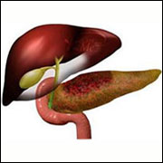
OBSTRUCTIVE JAUNDICE

Slide 2
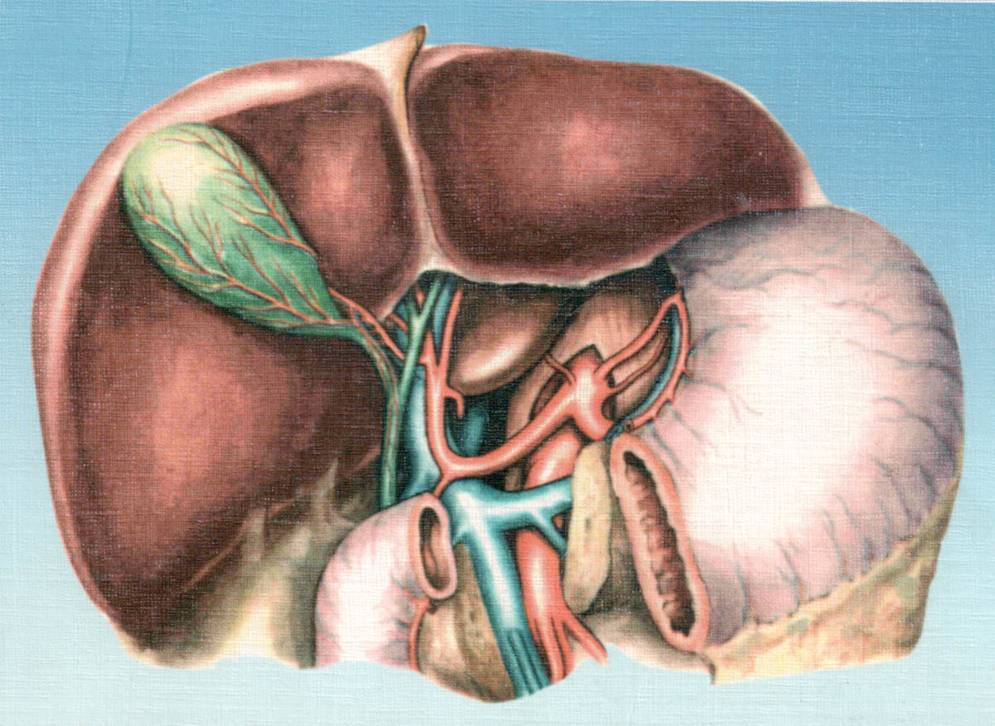

Slide 3
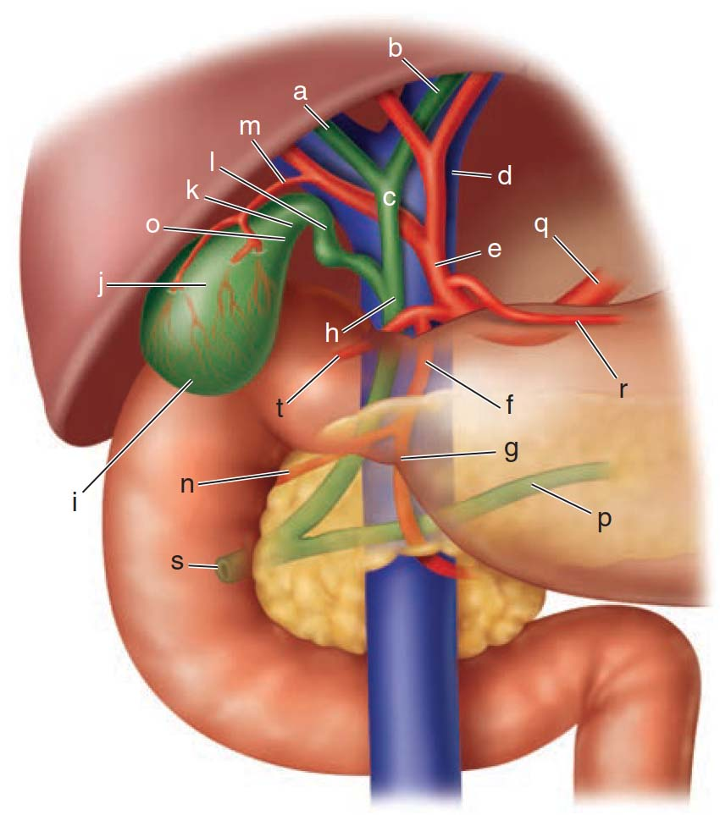
Figure 32-1. Anterior aspect of the biliary anatomy. a = right hepatic duct; b = left hepatic duct; c = common hepatic duct; d = portal vein; e = proper hepatic artery; f = gastroduodenal artery; g = right gastroepiploic artery; h = common bile duct; i = fundus of the gallbladder; j = body of gallbladder; k = infundibulum of the gallbladder; l = cystic duct; m = cystic artery; n = superior pancreaticoduodenal artery; o = neck of the gallbladder; p = pancreatic duct; q = common hepatic artery; r = right gastric artery; s = ampulla of Vater; t = supraduodenal artery.

Slide 4
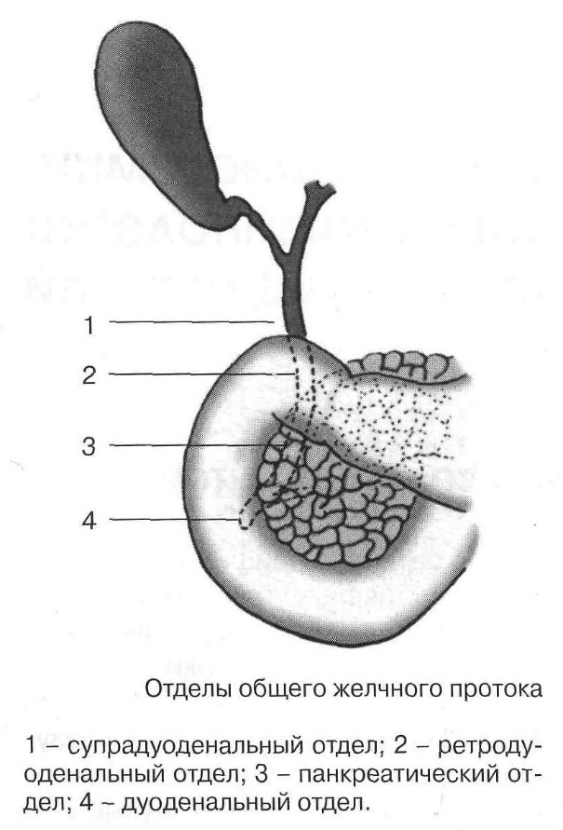
Parts of the common bile duct:
1- supraduodenal part;
2 - retroroduodenal part;
3 - pancreatic part;
4 - duodenal part.

Slide 5
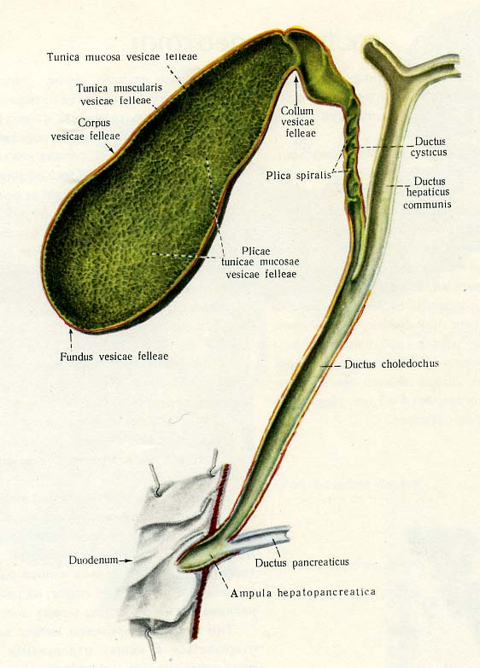
Surgical anatomy of the gall bladder and the bile duct
Notes:
Gallbladder, cystic duct, Right hepatic duct, left hepatic duct, common hepatic duct, pancreatic duct, common bile duct, ampulla of Vater, sphincter of Oddi

Slide 6
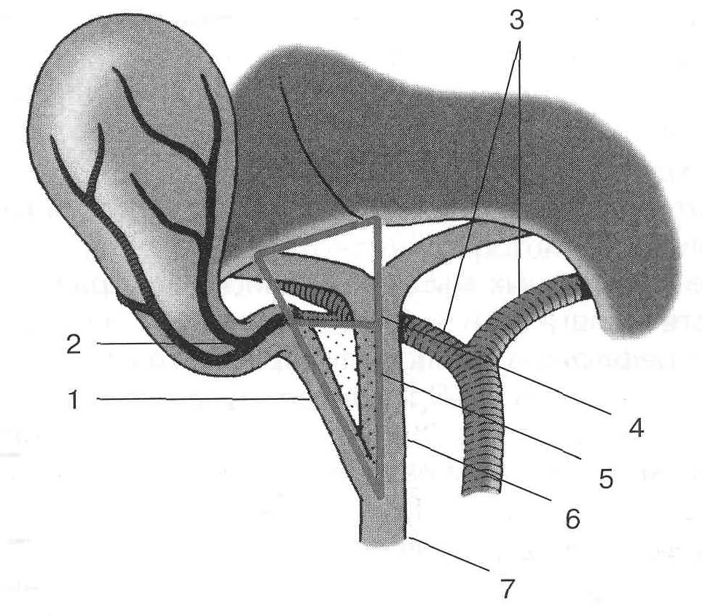
Calot's triangle (Треугольник Кало)
1 – cystic duct; 2 – cystic artery (пузырная артерия); 3 – правая и левая печеночная артерии; 4 – hepatobiliary triangle (печеночнопузырный треугольник); 5 – Calot's triangle(Треугольник Кало, заштрихован); 6 – common hepatic duct; 7 – common bile duct.
Notes:
Gallbladder, cystic duct, Right hepatic duct, left hepatic duct, common hepatic duct, pancreatic duct, common bile duct

Slide 7
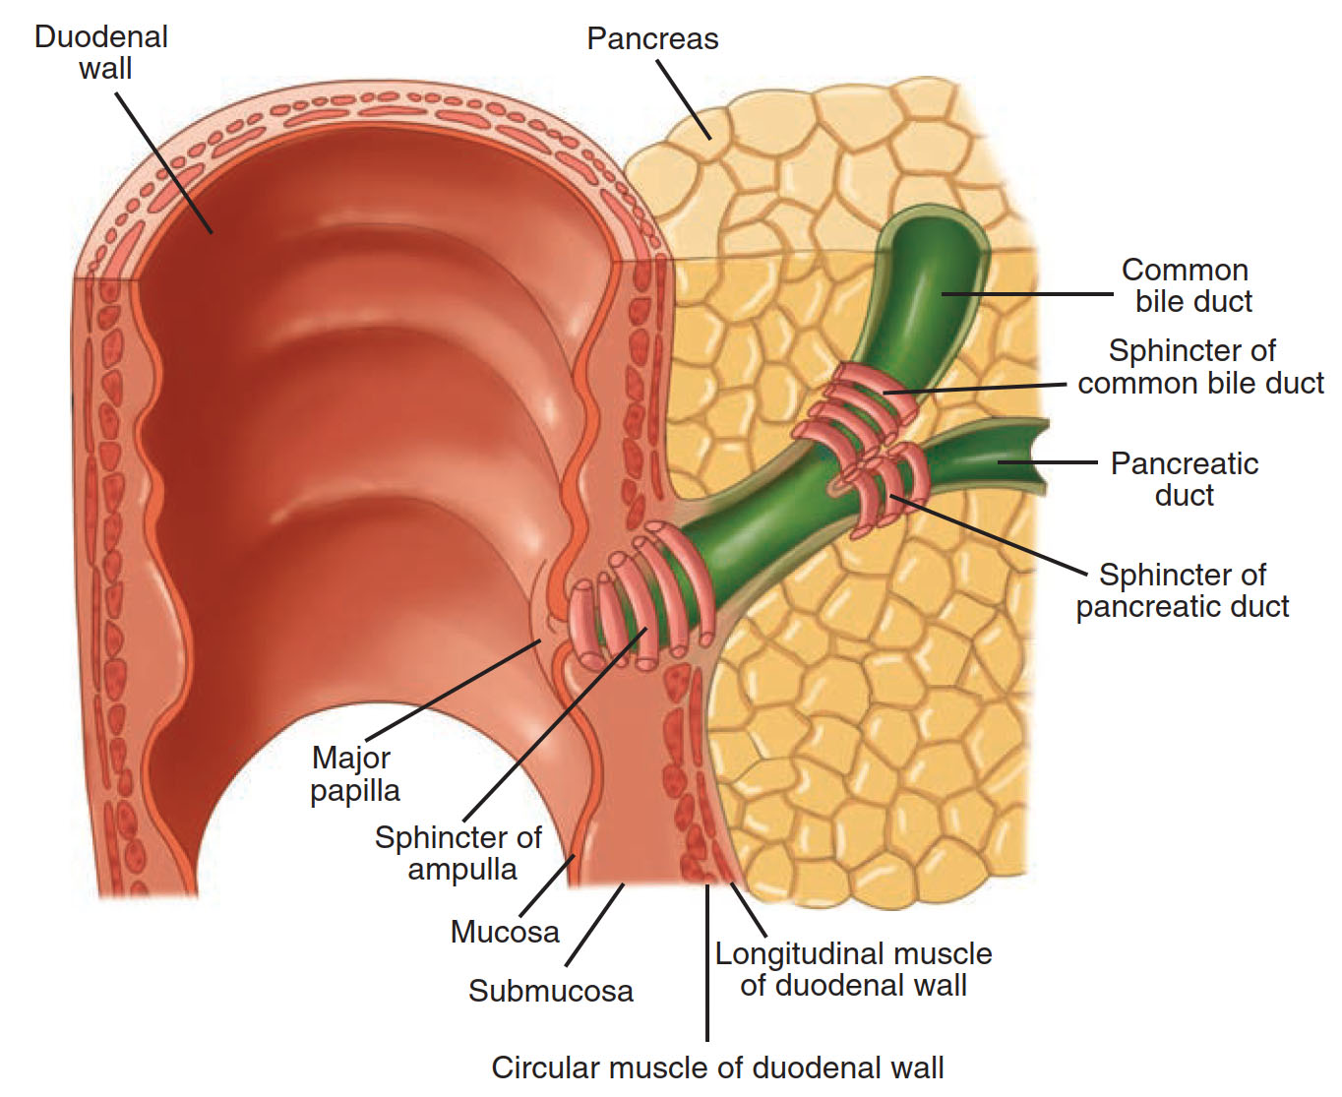
Schematic diagram of the ampullary, biliary, and pancreatic duct sphincters.

Slide 8
Obstructive jaundice is a condition in which there is a significant obstacle to the outflow of bile into the duodenum.

Slide 9
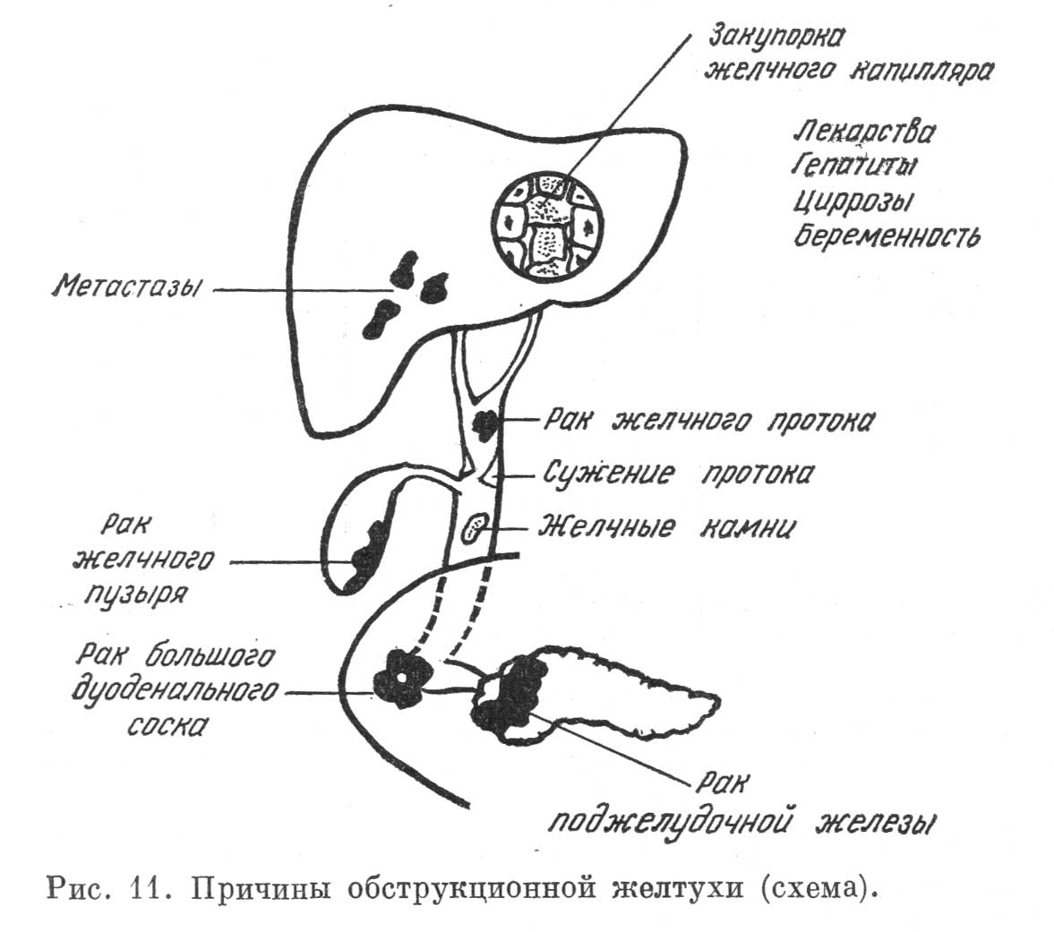
Notes:
Механическая желтуха может быть подпеченочной, если препятствие локализуется во внепеченочных желчных ходах, и внутрипеченочной, если сдавлены расположенные в паренхиме печени магистральные желчные протоки.

Slide 10
CAUSES OF OBSTRUCTIVE JAUNDICE
1. Malformations:
• atresia of the biliary tract;
• bile duct hypoplasia;
• cysts of the common bile duct;
• duodenal diverticulums located near the large duodenal papilla.
2. Benign diseases of the biliary tract:
• gallstone disease complicated by cholangiolithiasis;
• hammered in stones of a large duodenal papilla;
• strictures of the bile ducts;
• stenosis of the large duodenal papilla.

Slide 11
CAUSES OF OBSTRUCTIVE JAUNDICE (CONTINUED)
3. Inflammatory diseases:
• acute cholecystitis with a periprocess;
• cholangitis;
• pancreatitis (acute or chronic inductive);
• a cyst of the head of the pancreas with compression of the common bile duct;
• acute papillitis.
4. Tumors:
• cancer of the liver and common bile ducts;
• cancer of the large duodenal papilla;
• cancer of the head of the pancreas;
• metastases and lymphomas in the gates of the liver;
• papillomatosis of the bile ducts.
5. Parasitic diseases of the liver and bile ducts.
• echinococcosis or alveococcosis in the area of the liver gate.

Slide 12
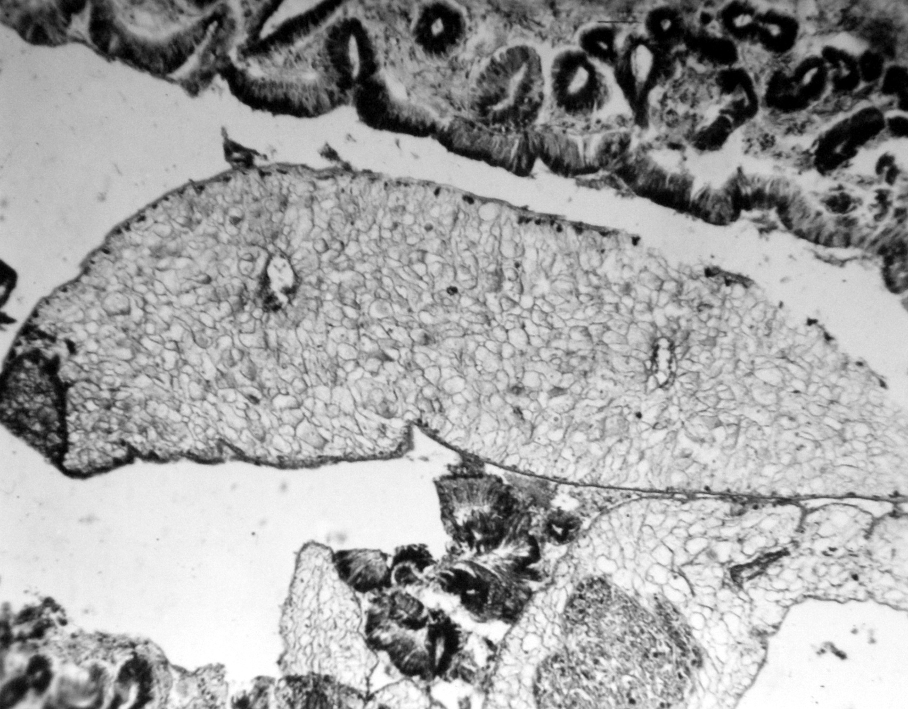
PARASITIC DISEASES OF THE LIVER
Opistorchis felineus in the bile duct

Slide 13
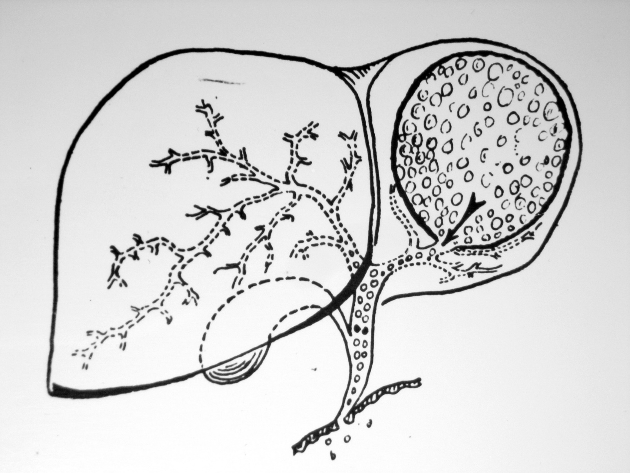
PARASITIC DISEASES OF THE LIVER
Breakthrough of a cyst with echinococcosis of the liver

Slide 14
E.I. Halperin in 2002 proposed a modified classification of strictures of the bile ducts:
Six types of strictures are distinguished: stricture type “+2” - stump of altered common hepatic duct more than 2 cm; "+1" - the stump of the common hepatic duct 1-2 cm; “0” - stump of the common hepatic duct less than 1 cm; “-1” - there is no stump of the common hepatic duct; the superior posterior arch of the hepatic duct confluences is preserved; "-2" - the zone of hepatic duct confluence is destroyed, stumps of the lobar ducts are preserved; "-3" - cicatricial inflammatory lesion of the segmental ducts.

Slide 15
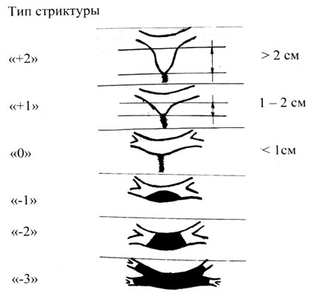

Slide 16
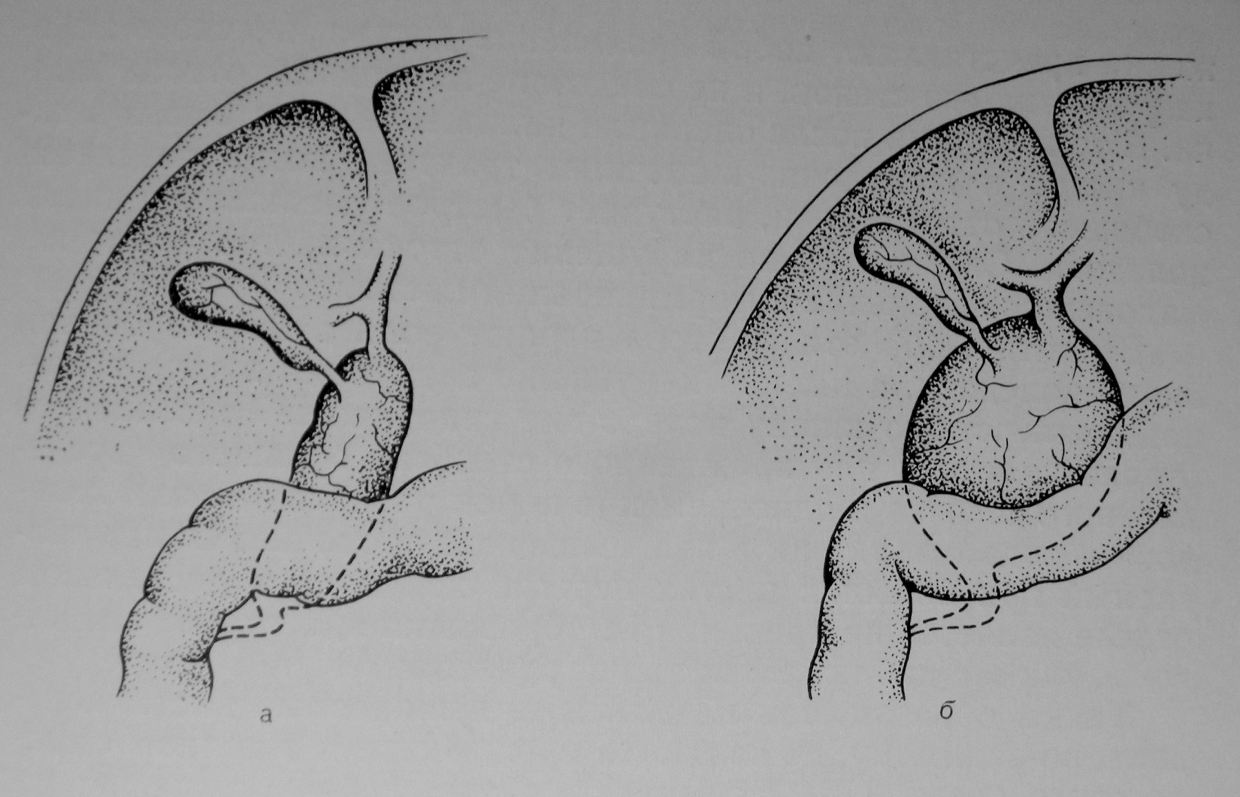
Malformations of the biliary tract. Congenital cysts of the common bile duct (Caroli disease)
а – sausage shape; б – spherical shape

Slide 17
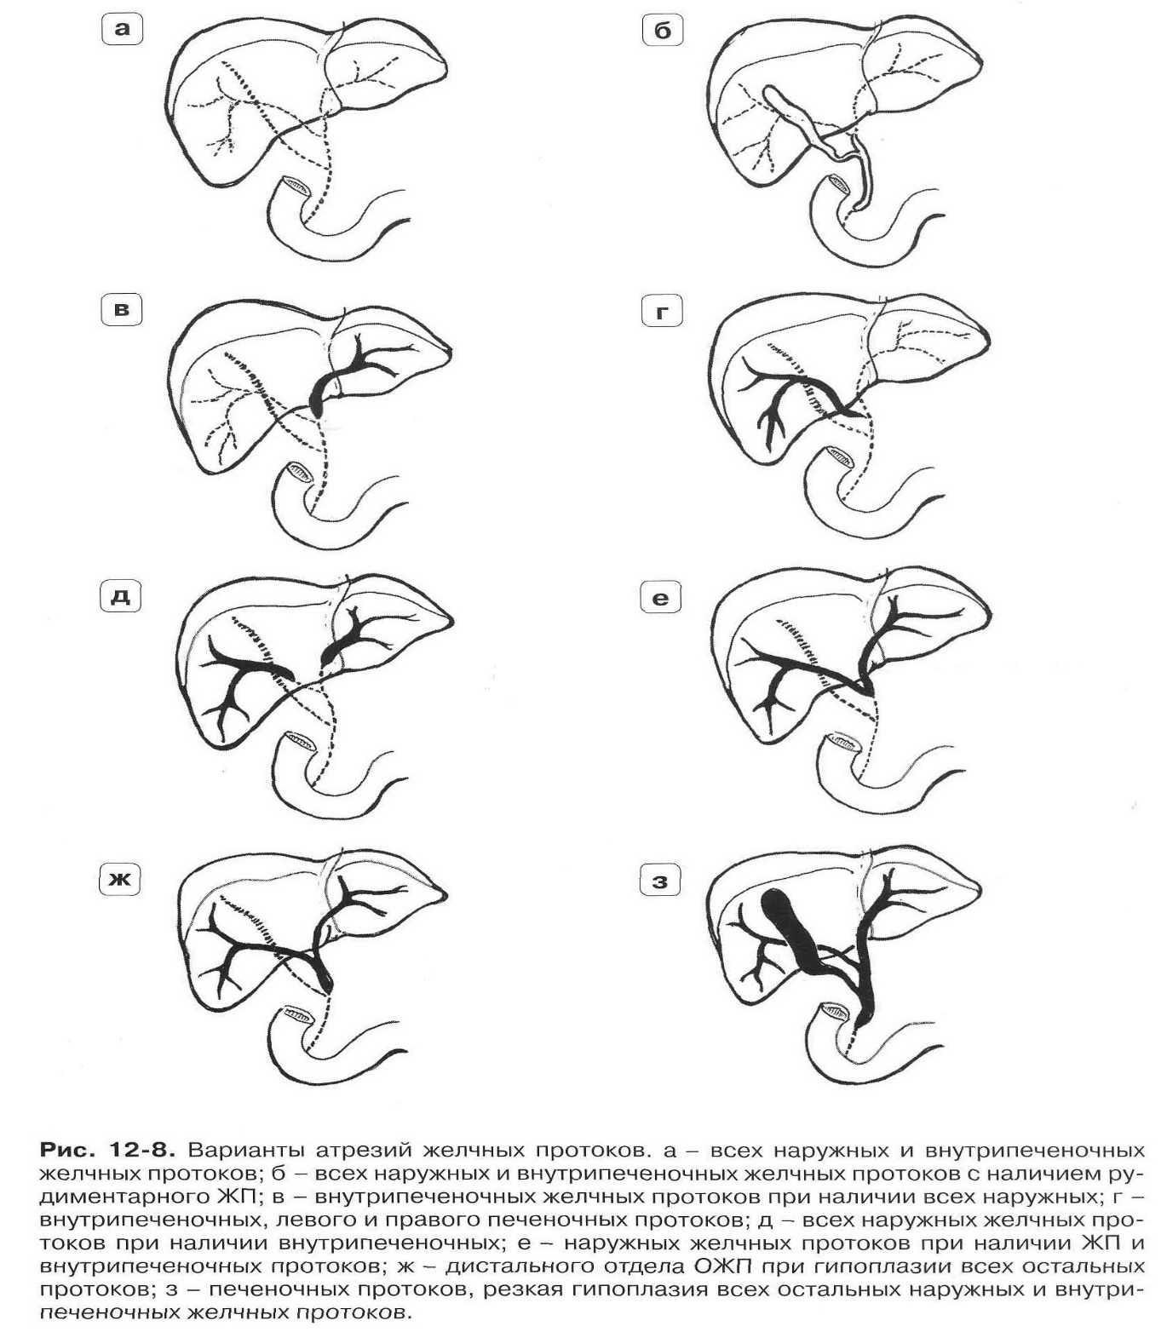
Options for atresia of the bile ducts, a - all external and intrahepatic bile ducts; б - all external and intrahepatic bile ducts with the presence of a rudimentary gallbladder; в - intrahepatic bile ducts in the presence of all external; г - intrahepatic left and right hepatic ducts; д - all external bile ducts in the presence of intrahepatic; e - external bile ducts in the presence of the gallbladder and intrahepatic ducts; ж - the distal section of the common bile duct with hypoplasia of all other ducts; з - hepatic ducts, severe hypoplasia of all other external and intrahepatic bile ducts.

Slide 18
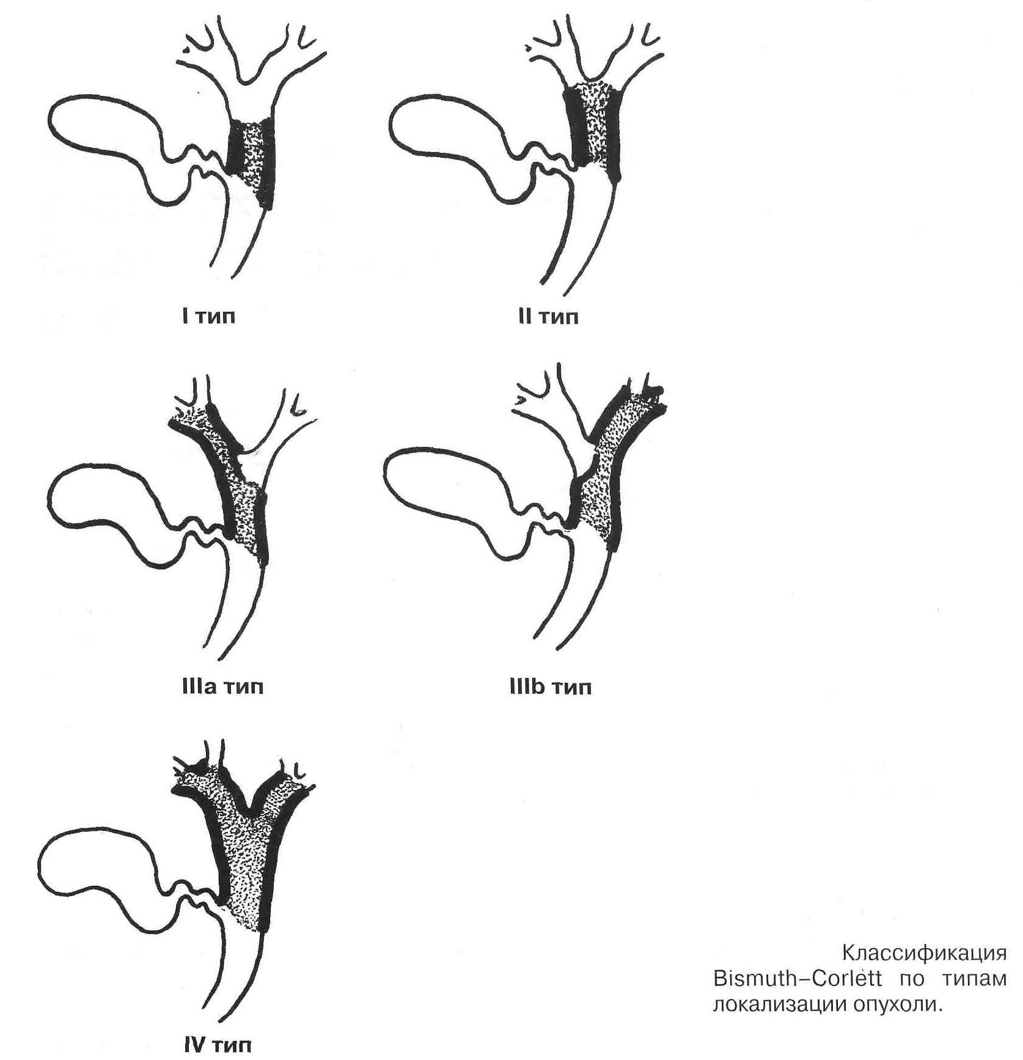
Klatskin tumor

Slide 19
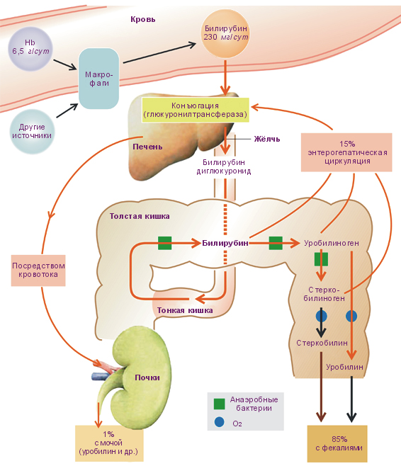
Notes:
При разрушении эритроцитов гемоглобин расщепляется на глобин, железосодержащий гемосидерин и не содержащий железа гематоидин. Гематоидин превращается через стадию биливердина в билирубин.
Образующийся билирубин поступает в кровь. Так как он не растворим в воде при физиологическом pH крови, то для транспортировки в крови он связывается с носителем — главным образом, альбумином.
Печень выполняет три важнейшие функции в обмене билирубина: захват из крови гепатоцитами, связывание билирубина с глюкуроновой кислотой и выделение связанного (конъюгированного) билирубина из гепатоцитов в желчные капилляры.
Билирубин поступает в кишечник и под действием бактериальных дегидрогеназ превращается в мезобилиноген и уробилиногеновые тельца: уробилиноген и стеркобилиноген. Основное количество уробилиногена из кишечника выделяется с калом в виде стеркобилиногена (60–80 мг в сутки), на воздухе превращающегося в стеркобилин, что окрашивает кал в коричневый цвет. Часть уробилиногена всасывается через стенку кишечника и попадает в воротную вену, затем в печень, где расщепляется. Здоровая печень полностью расщепляет уробилин, поэтому в норме в моче он не определяется.
Часть стеркобилиногена через систему геморроидальных вен попадает в общий кровоток и выводится почками (около 4 мг в сутки), придавая моче нормальный соломенно-желтый цвет.

Slide 20
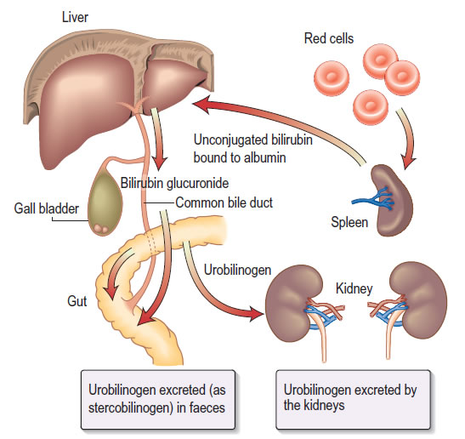

Slide 21
MAIN PATHOGENETIC LINK OF MECHANICAL JAUNDICE:
Disturbance of excretion of bilirubin and bile acids through extrahepatic bile ducts
Notes:
Следует четко различать желтуху и холестаз.
Механическая желтуха, нарушая от­ток желчи и вызывая регургитацию всех ее компонентов в кровь, всегда сопровождается холестазом.
В отличие от желтухи холестазом является такое патологическое состояние, при котором происходит нарушение выделения не только билирубина, но и всех остальных составных частей желчи — желчных кислот, холестерина и фосфолипидов.

Slide 22
Biliary hypertension leads to rupture of the walls of the bile ducts, diffusion of the bile pigment into the lymph spaces, and then into the blood vessels.
With hypertension above 300 mm Hg, bile can directly enter the sinusoids of the liver, and then through the system of hepatic veins into the general bloodstream.
Notes:
наибольшее значение в нарушении функции гепатоцита при холестазе имеет накопление в нем билирубина и желч­ных кислот. Билирубин в концентрациях, типичных для холе­стаза, снижает потребление кислорода гепатоцитом и разобща­ет окислительное фосфорилирование. Однако наибольшее значение для функции гепатоцита имеет задержка и накопление в нем желчных кислот.
Желчные кислоты при значительной концентрации обнаруживают детергентное действие на мик­росомы, выраженное тем сильнее, чем концентрация их больше.

Slide 23
Decreased protein-synthetic function of the liver, impaired absorption of fat-soluble vitamins, vitamin K deficiency impaired synthesis of vitamin K-dependent coagulation factors — prothrombin, proconvertin, factors IX and X
HYPOCAAGULATION
Notes:
Значительно быстрее уменьшается содержание белков, имеющих короткий период полураспада. К ним в первую оче­редь относятся витамин-К-зависимые факторы свертывания крови (II, VII, IX, X). Это зависит не только от постепенного снижения функции печени, но и от развивающегося в орга­низме дефицита витамина К, поскольку из-за отсутствия жел­чи в кишечнике нарушено всасывание жиров и жирораствори­мых витаминов.
При механической желтухе полное или частичное отсутствие желчи приводит к нарушению всасывания жирорастворимых витаминов, и в организме возникает дефи­цит витамина К. Это ведет к нарушению синтеза витамин-К-зависимых факторов свертывания крови—протромбина, проконвертина, факторов IX и X. Возникает выраженная гипокоагуляция, приводящая к повышенной кровоточивости.

Slide 24
Changes in organs and systems with obstructive jaundice
From the cardiovascular system: bradycardia, decreased blood pressure;
Hemorrhages as a result of violation of the integrity of the vascular walls;
From the side of the central nervous system: general asthenization, increased fatigue, emotional disturbances, irritability, which is replaced by depression, drowsiness during the day and sleeplessness at night, headache;
On the part of the skin: itching;
In the blood: erythrocyte hemolysis, leuko-, thrombocytolysis;
In tissues damaged by bile acids: inflammation (peritonitis, acute pancreatitis), liver necrosis.
Notes:
со стороны сердечно-сосудистой системы: брадикардию, снижение артериального давления, которое объясняется действием желчных кислот на рецепторы
и центр блуждающего нерва, синусно-предсердный узел и кровеносные сосуды;
геморрагии в результате нарушения целостности сосудистых стенок;
• со стороны ЦНС: общую астенизацию, повышенную утомляемость, эмоциональные нарушения раздражительность, которая сменяется депрессией, сонливость днем и бессонницу ночью, головную боль при токсическом воздействии желчных кислот на головнои мозг;
• со стороны кожи: зуд, обусловленный раздражением чувствительных нервных окончании кожи желчными кислотами;
• в крови: гемолиз эритроцитов, лейко-, тромбоцитолиз в результате детергентного действия желчных кислот на мембраны клеток;
• в тканях, поврежденных желчными кислотами: воспаление (перитонит, острый панкреатит), некроз печени.

Slide 25
Acholia - a pathological condition associated with missed bile in the intestines
Colonization of bacteria and their translocation into portal blood.
Stopping the emulsification of bacterial endotoxin by bile acids, which leads to an increase in its concentration in portal blood.
The functional stress of Kurfer cells caused by biliary hypertension does not provide “containment” of endotoxin and bacteria in the sinusoids of the liver, which leads to their breakthrough into the central vein and systemic blood flow.

Slide 26
CLINIC OF OBSTRUCTIVE JAUNDICE
1. Pain syndrome:
Acute paroxysmal pain (with a pressure in the intestinal tract> 350-400 mm of water. Art.)
Dull aching pain. There are also painless forms. (26 to 66% of cases)
Possible irradiation of pain

Slide 27
Clinic of obstructive jaundice
2. A feeling of heaviness in the epigastrium and right hypochondrium.
3. Dyspeptic disorders:
vomiting (reflexively, due to intoxication, from compression);
lack of appetite;
weight loss;
constipation
diarrhea (with prolonged course of jaundice);

Slide 28
Clinic of obstructive jaundice
4. Cholangitis (50 - 70% of cases)
Temperature increase up to 38 - 39 оС
Chills, pain (Charcot Triad)
5. Yellowness (ictericity) of the skin and sclera
  with a serum bilirubin level> 34.2 μmol / L
  jaundice may be intermittent

Slide 29
Charcot triad
Pain in the right hypochondrium
Jaundice
Febrile hyperthermia

Slide 30
PENTAD REYNOLDS
Pain in the right hypochondrium
Jaundice
Febrile hyperthermia
Hypotension
Encephalopathy

Slide 31
Clinic of obstructive jaundice
6. Skin itching, scratching
7. Hemorrhagic diathesis
8. An increase in the size of the liver
"Liver hump"
"Rocky density" - a symptom of Lyubimov
9. Symptom of Courvoisier (in 80% of cases) - an enlarged painless gall bladder

Slide 32
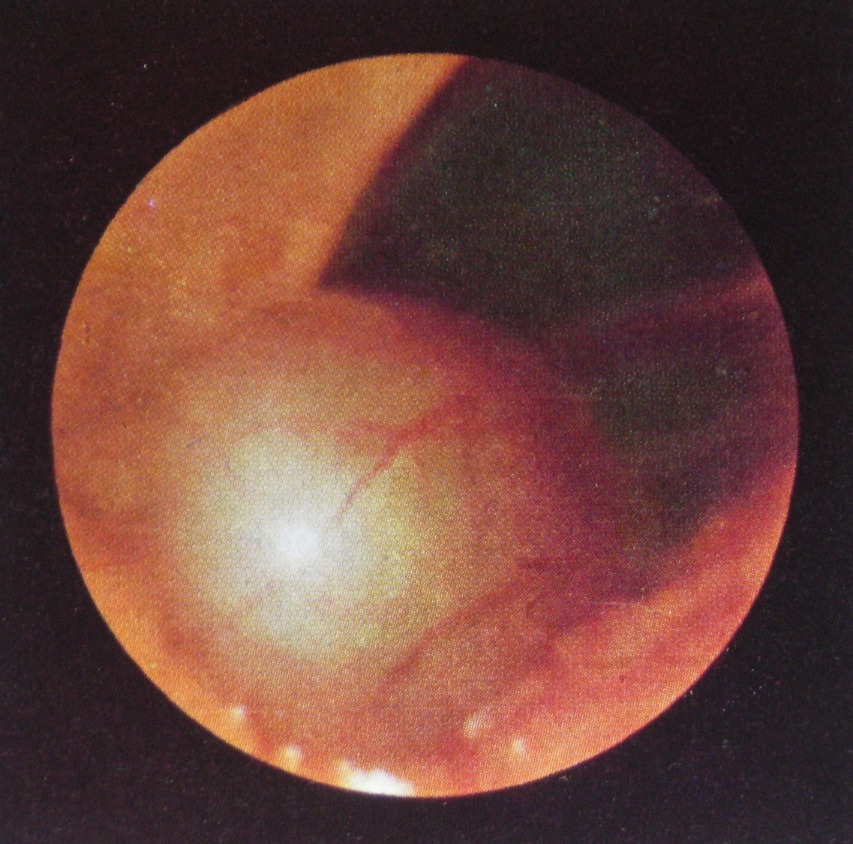
Clinic of obstructive jaundice
Symptom Courvoisier
(photo with laparoscopy in a patient with a tumor of the pancreatic head)

Slide 33
Syndrome Courvoisier-Terrier:
Enlarged painless gall bladder;
Jaundice of the skin and mucous membranes with severe itching;
Acholic feces.
Notes:
описан хирургами – швейцарским L. G. Courvoisier, 1843–1918, французским L.-F. Terrier, 1837–1908) – симптомокомплекс (триада) при опухоли фатерова соска: увеличенный желчный пузырь (Курвуазье – Террье правило: увеличенный желчный пузырь является признаком опухоли фатерова соска), желтуха кожи и слизистых оболочек с выраженным зудом, ахоличный кал. Аналогичный симптомокомплекс при опухоли поджелудочной железы носит название синдрома (правила) Бара – Пика.

Slide 34
Clinic of obstructive jaundice
10. Portal hypertension
Dilation of the saphenous veins of the anterior abdominal wall in the form of a “jellyfish head”
"Frog belly" due to ascites
Esophageal dilatation
Hemorrhoidal enlargement
11. Hepatic failure
Hepatic encephalopathy develops, up to the hepatic coma

Slide 35
Classification of obstructive jaundice
  By the degree of bilirubinemia
light (total bilirubin ≤ 100 μmol / l)
medium (total bilirubin 101-200)
severe (total bilirubin ≥ 201)

Slide 36
CLASSIFICATION OF OBSTRUCTIVE JAUNDICE
According to the clinical course
acute
progressive
stable
intermittent
recurrent
chronic

Slide 37
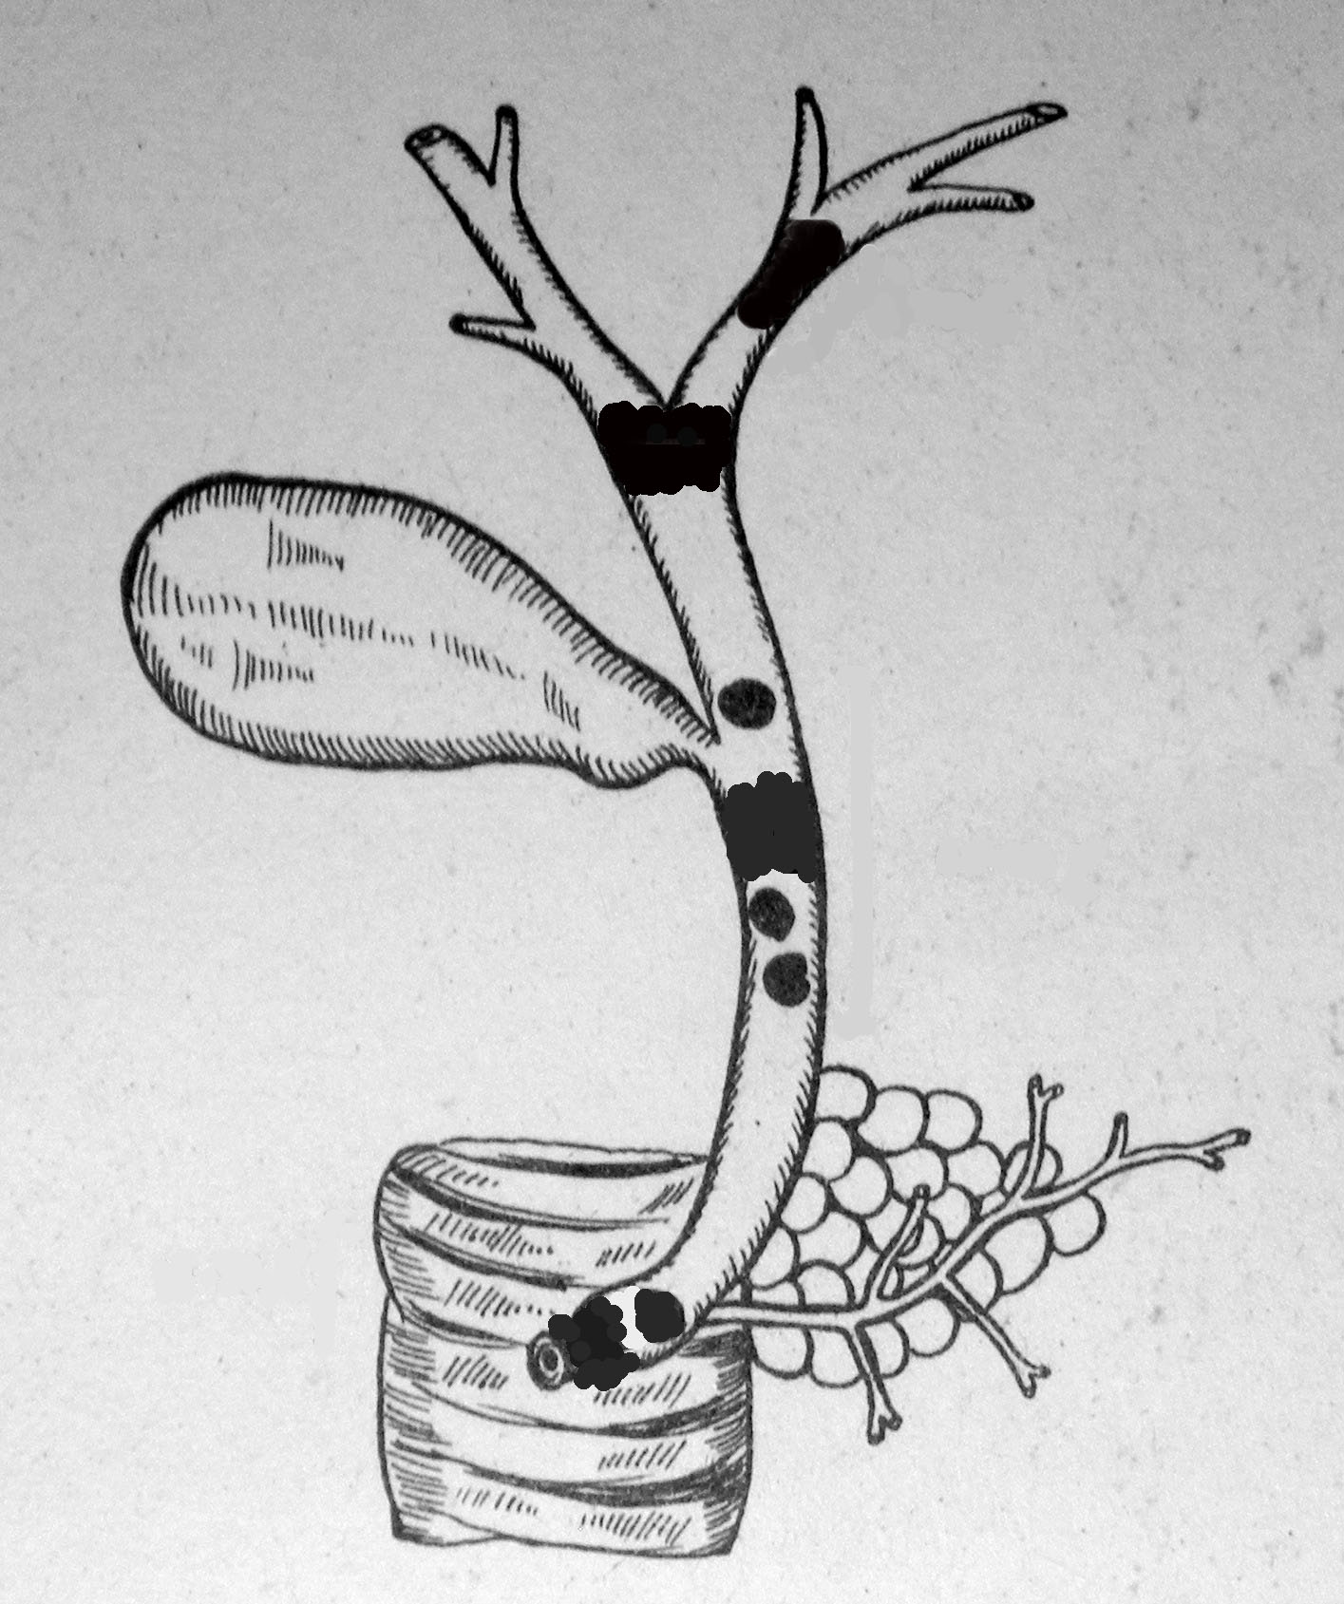
Classification of obstructive jaundice
By the level of the biliary tract block:
high block (liver gate)
middle block (hepatic choledochus)
low block (distal choledoch, BDS, pancreas head)

Slide 38
CLASSIFICATION OF OBSTRUCTIVE JAUNDICE
By the presence of complications
Uncomplicated
Complicated:
- cholangitis
- liver failure

Slide 39
Diagnosis of obstructive jaundice is carried out in several stages
The task of the 1st stage is to identify the mechanical nature of jaundice, that is, to differentiate obstructive jaundice from hemolytic and parenchymal.
The task of the 2nd stage is to establish the cause, to determine the disease that led to the obstruction of the ducts
The task of the 3rd stage is to find out the level of obstruction of the biliary tract and determine the tactics

Slide 40
DIFFERENTIAL DIAGNOSIS OF OBSTRUCTIVE JAUNDICE
1. Hemolytic (suprahepatic) jaundice
  - jaundice combined with splenomegaly, anemia
  - indirect bilirubin prevails
2. Parenchymal (hepatic) jaundice
  - indirect bilirubin increased immediately
  - serological testing for hepatitis (markers)
  - Ultrasound, ERCP (ducts not expanded)

Slide 41
DIAGNOSTIC ALGORITHM
Clinical identification (on-alertness!)
Laboratory diagnostics
X-ray methods
Ultrasound scan
Level of a-fetoprotein (Abelev, Tatarinov, 1963) (+ result in 83.8% of hepatoma), tumor markers
Scintigraphy (beng. Pink, gold, technetium)
HHG, fistulography
ERCP
Angiography (celiacography), splenoportography, cavagraphy
CT, MRI with bolus contrast (omnipack)
Laparoscopy + biopsy, puncture (fine needle) biopsy

Slide 42
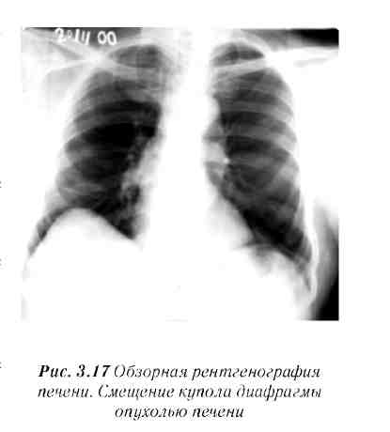
Panoramic radiography of the liver. Displacement of the dome of the diaphragm by a tumor of the liver

Slide 43
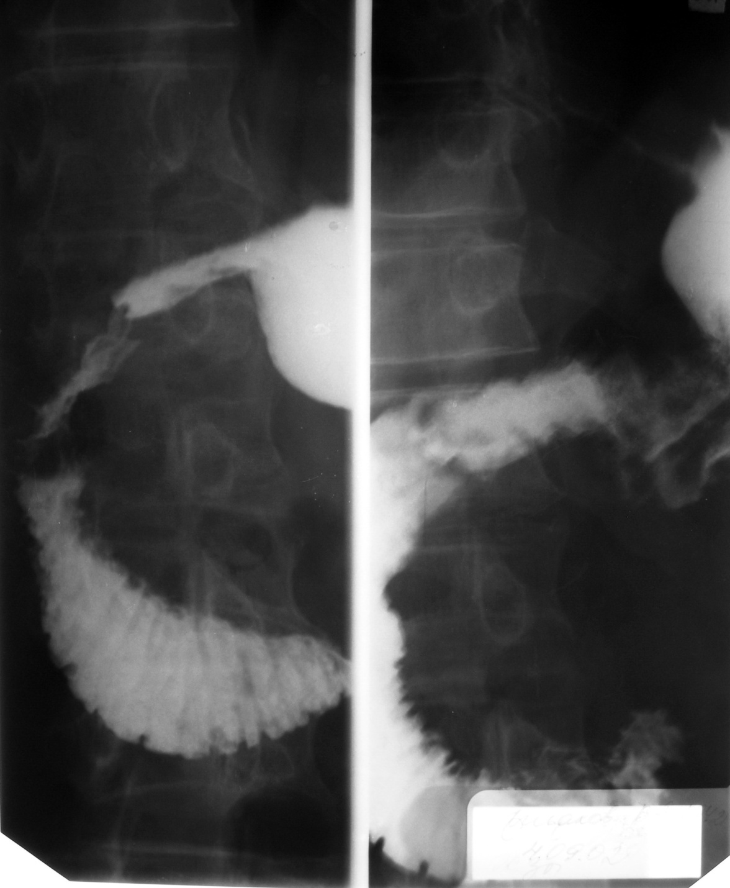
DIAGNOSIS OF OBSTRUCTIVE JAUNDICE
X-ray methods (development of the duodenum contour in a patient with a tumor of the pancreatic head) - better in conditions of hypotension (metacin)

Slide 44
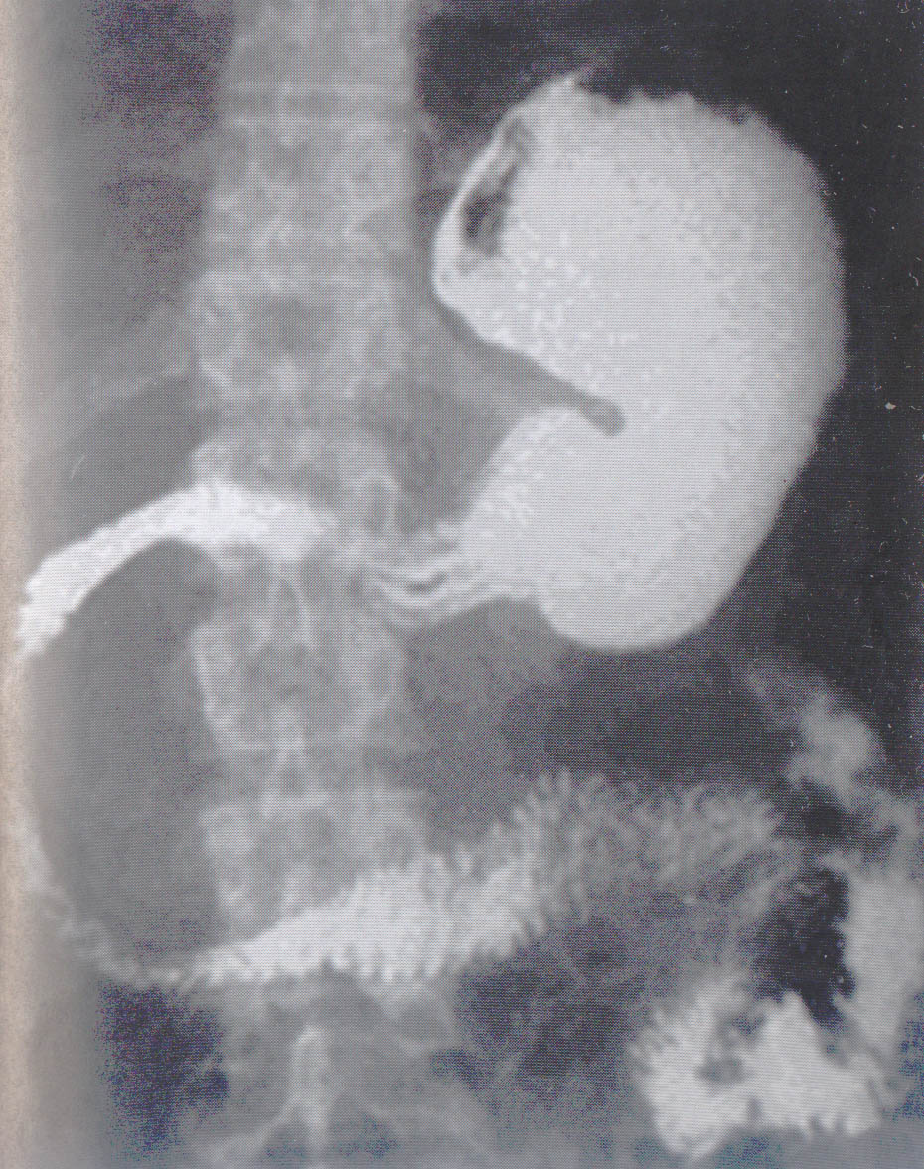
DEPLOYMENT OF THE CONTOUR OF THE DUODENUM

Slide 45
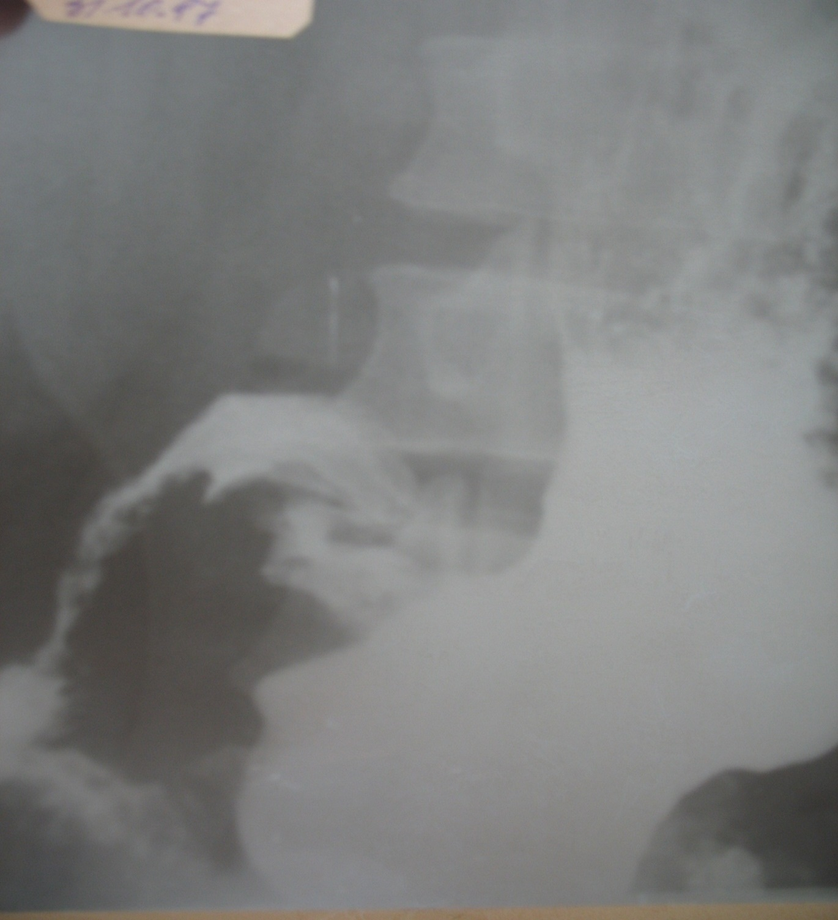

Slide 46
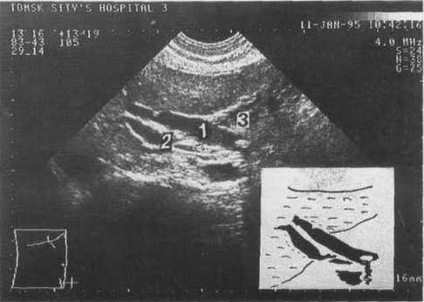
Ultrasound. Choledocholithiasis 1) common bile duct, 2) portal vein, 3) stone.

Slide 47
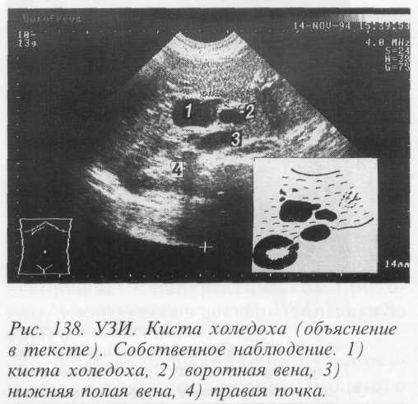
Ultrasound - cyst of the common bile duct

Slide 48
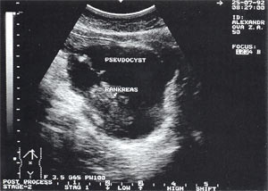

Slide 49
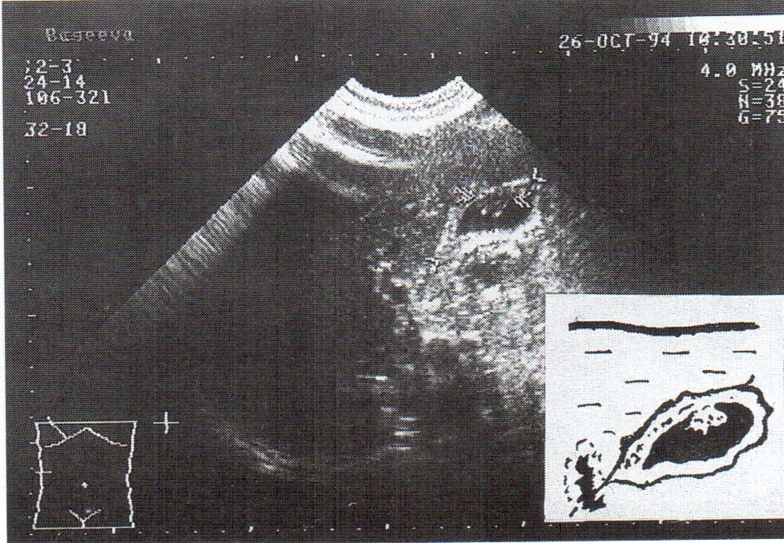
Ultrasound. Gall bladder cancer.

Slide 50
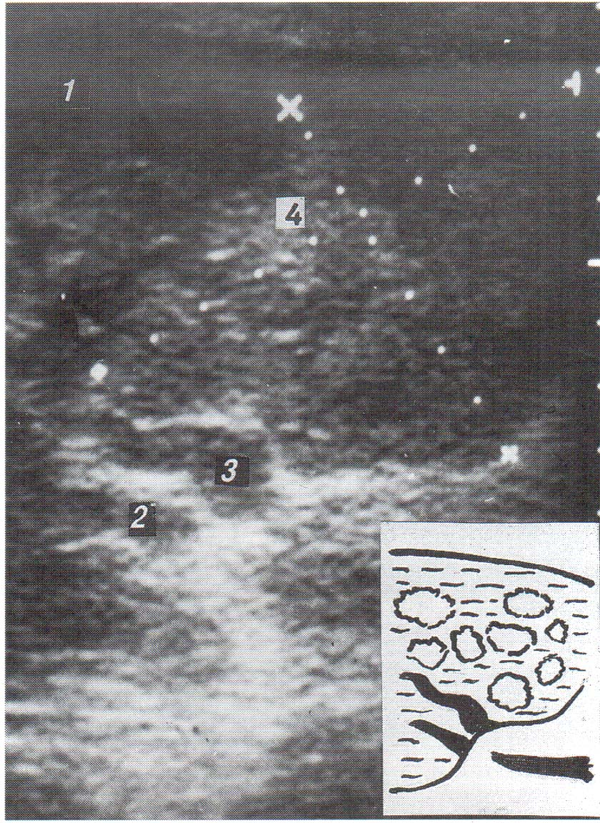
Ultrasound Primary liver cancer.

Slide 51
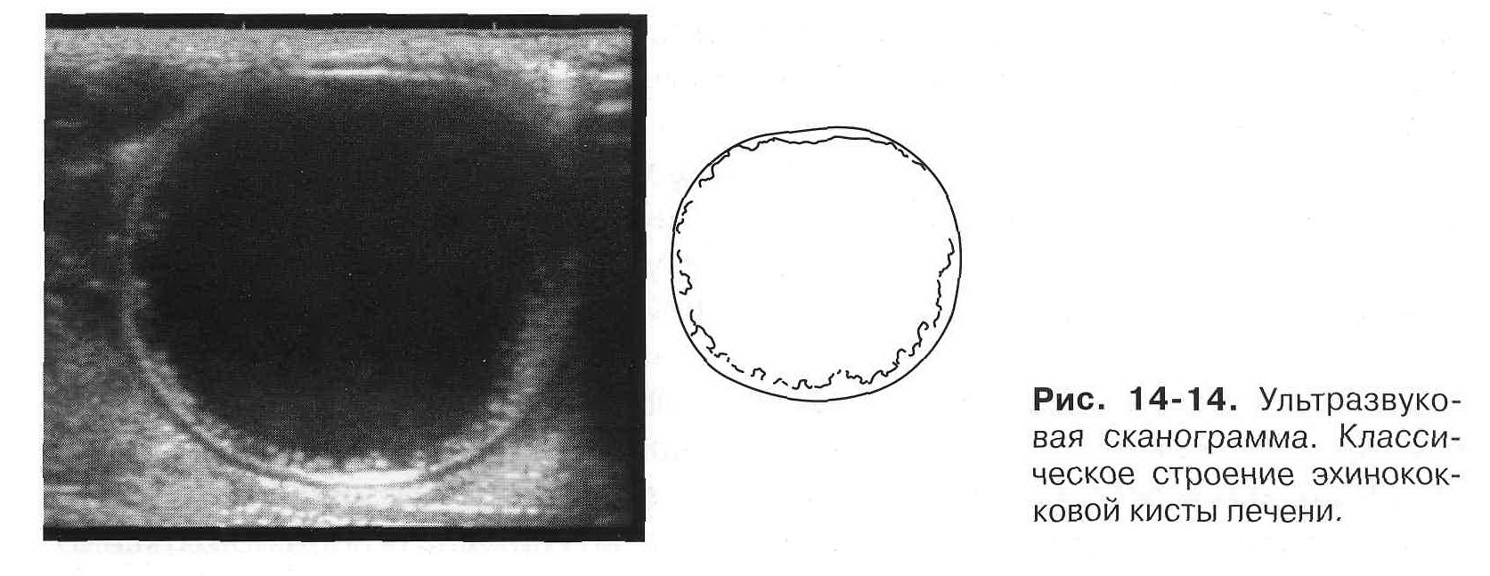
Ultrasound scan
The classic structure of echinococcal liver cysts

Slide 52
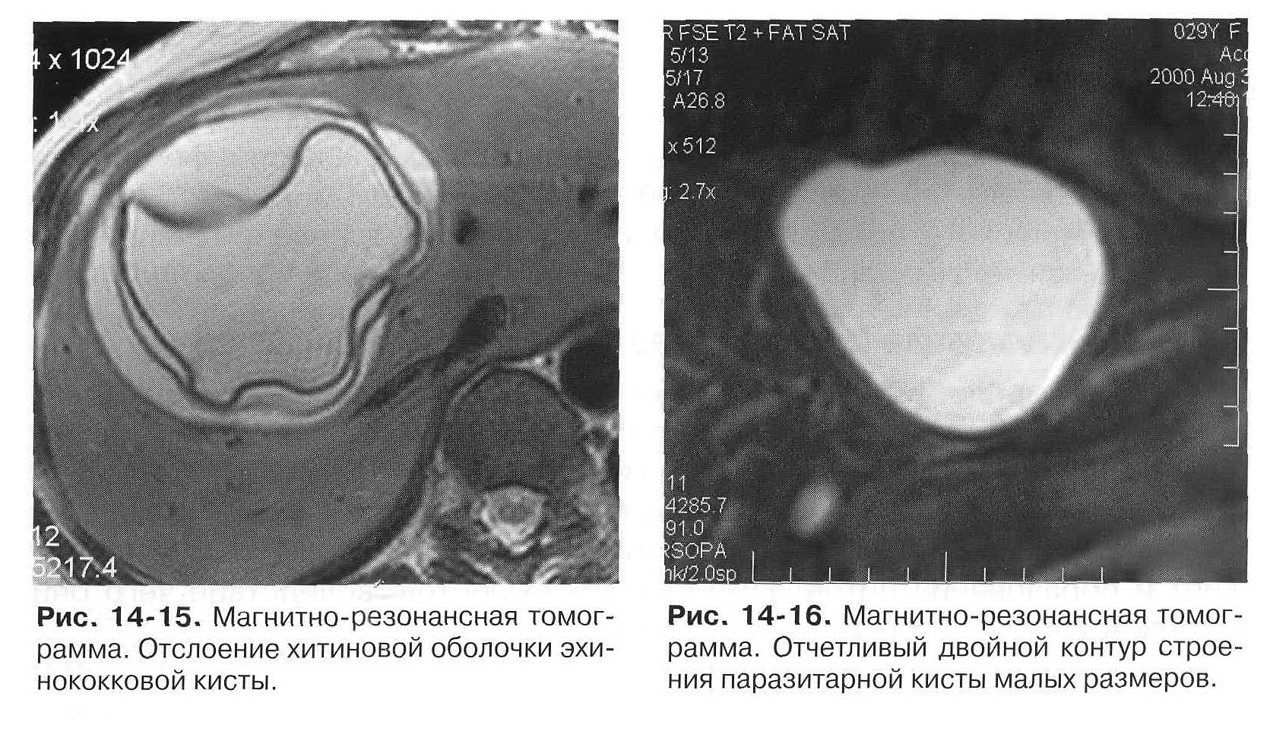
Magnetic Resonance Imaging
Exfoliation of the chitinous membrane of the echinococcal cyst
A distinct double outline of the structure of a small parasitic cyst

Slide 53
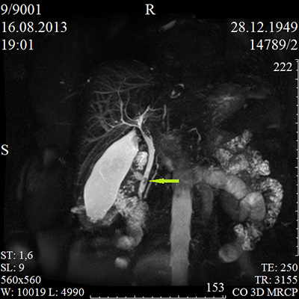
Magnetic resonance cholangiopancreatography (MRCP)
Notes:
Magnetic resonance cholangiopancreatography (MRCP) is a medical imaging technique that uses magnetic resonance imaging to visualize the biliary and pancreatic ducts in a non-invasive manner.^{[1]} This procedure can be used to determine if gallstones are lodged in any of the ducts surrounding the gallbladder.
Technique[edit]
MRCP makes use of heavily T2-weighted MRI pulse sequences.^{[3]} These sequences show high signal in static or slow moving fluids within the gallbladder, biliary ducts and pancreatic duct, with low signal of surrounding tissue.
Comparison to other techniques[edit]
In the diagnosis of pancreatic disorders, MRCP is a much less invasive investigation when compared to endoscopic retrograde cholangiopancreatography (ERCP). Although both techniques can image the ductal system in detail, MRCP also allows imaging of the surrounding parenchyma. In a study from 2008, 269 patients undergoing both ERCP and MRCP showed comparable results between the two techniques.^{[4]}

Slide 54
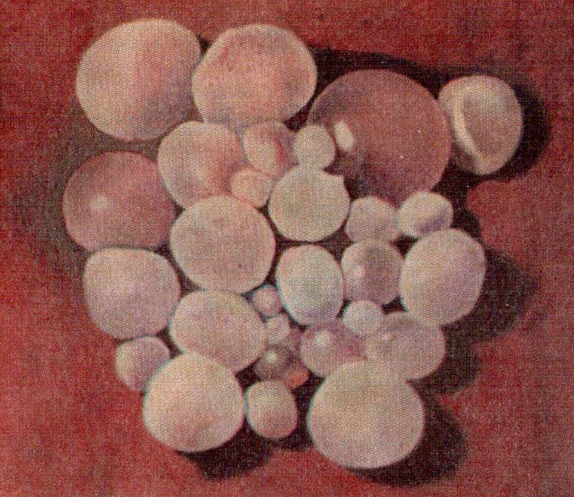
Echinococcal cysts (дочерние пузыри эхинококковой кисты)

Slide 55
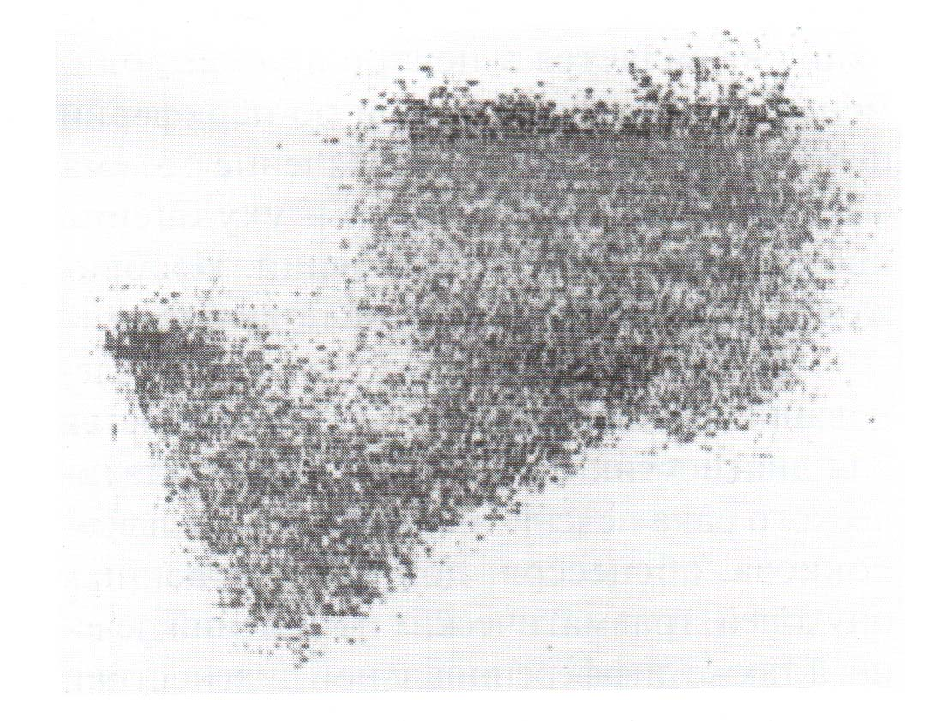
Scintigraphy (Бенг. розовый, золото)

Slide 56
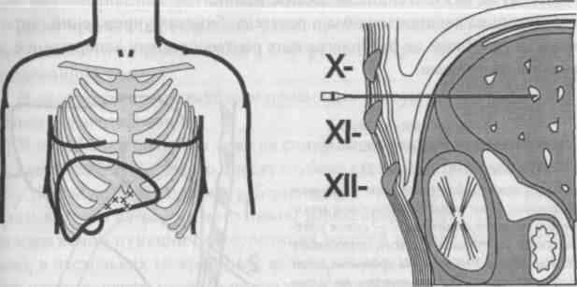
Scheme of percutaneous transhepatic cholangiography

Slide 57
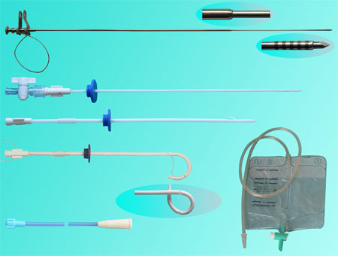

Slide 58
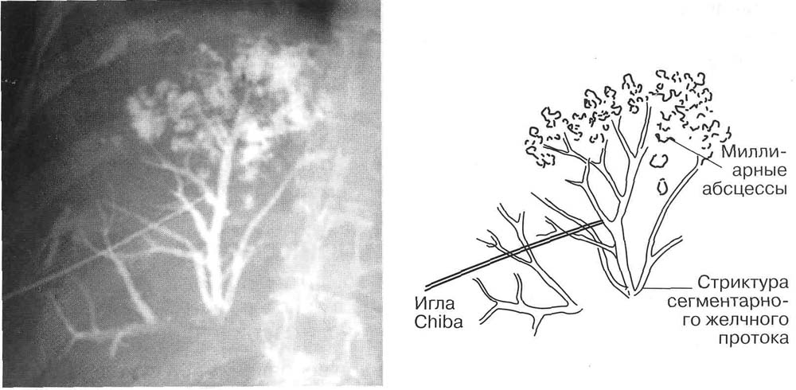
Percutaneous biliary drainage
Percutaneous transhepatic cholangiography of a patient with cicatricial stricture of a segmental bile duct with miliary abscesses.

Slide 59
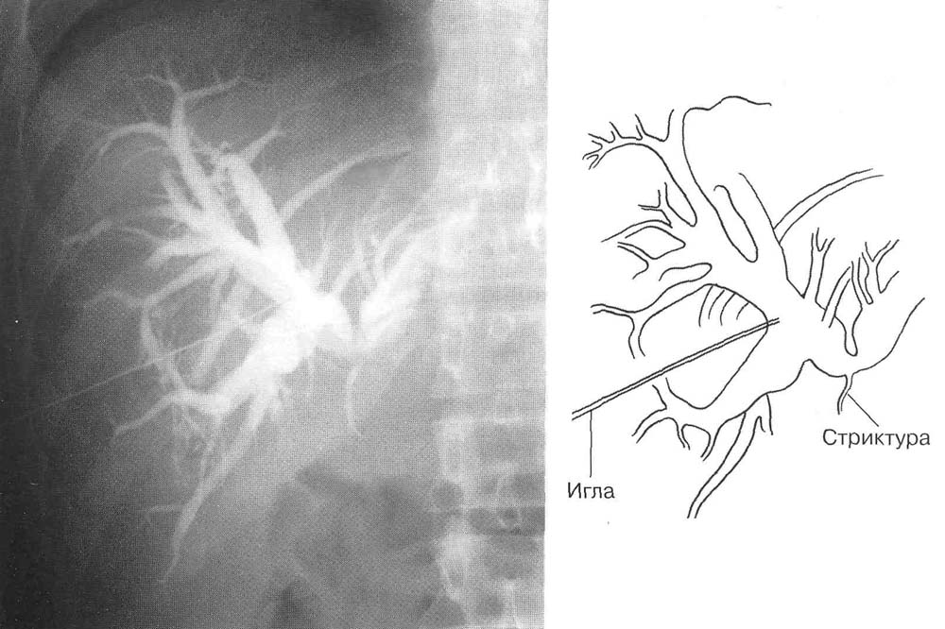
Percutaneous biliary drainage
Cicatricial stricture of the common hepatic duct.

Slide 60
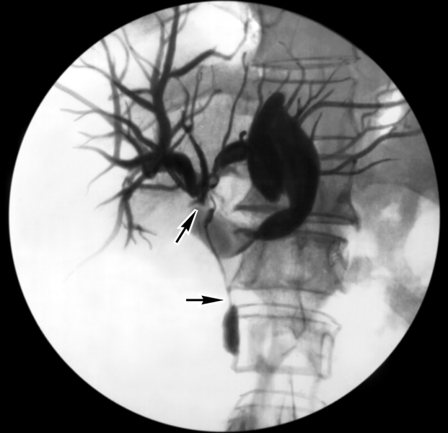
Percutaneous Transhepatic Cholangiography - Confluenza Tumor - Klatskina

Slide 61
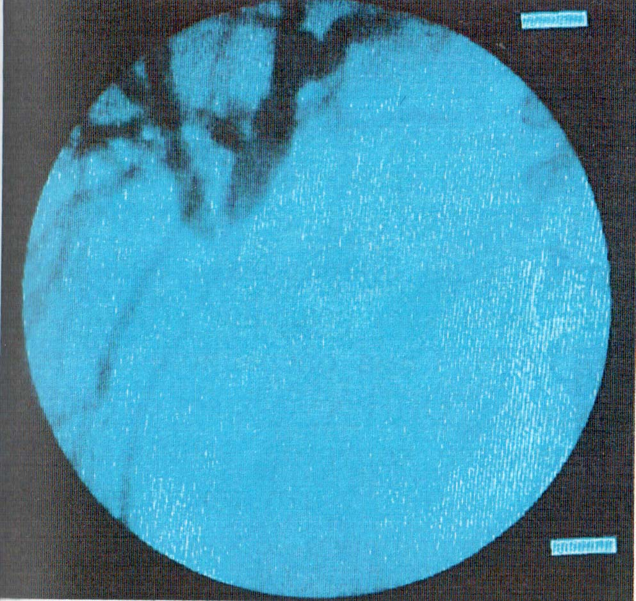
Percutaneous Transhepatic Cholangiography – Cholangiogram. Proximal choledochus tumor.

Slide 62
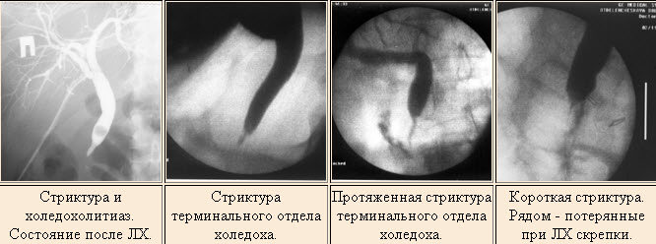
Fistulography - strictures of the common bile duct

Slide 63
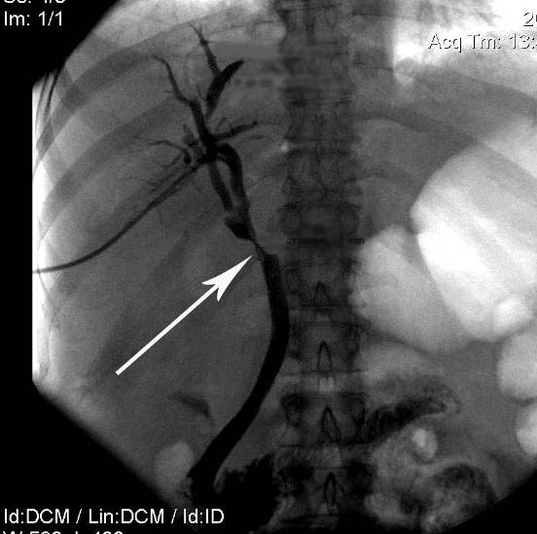
Fistulography - strictures of the common bile duct

Slide 64
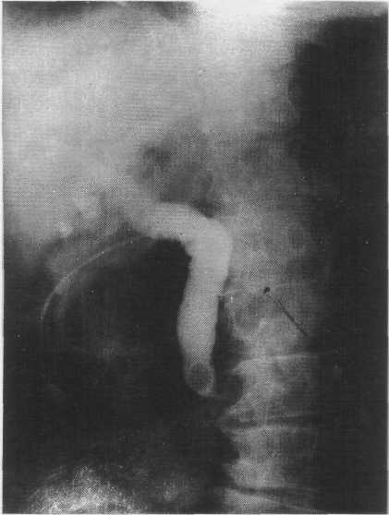
Фистулография – камень БДС
Fistulography - choledolithiasis

Slide 65
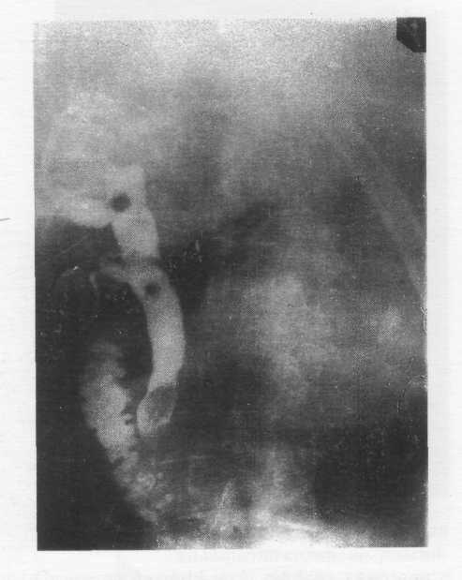
Fistulography - choledolithiasis

Slide 66
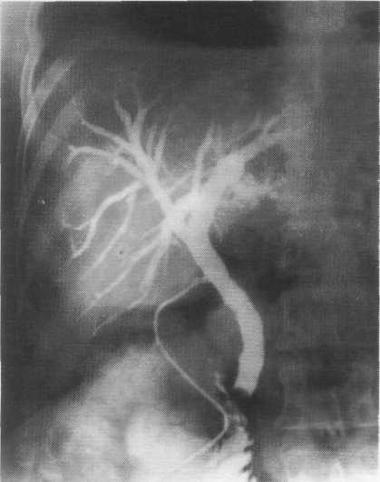
Fistulography - choledolithiasis

Slide 67
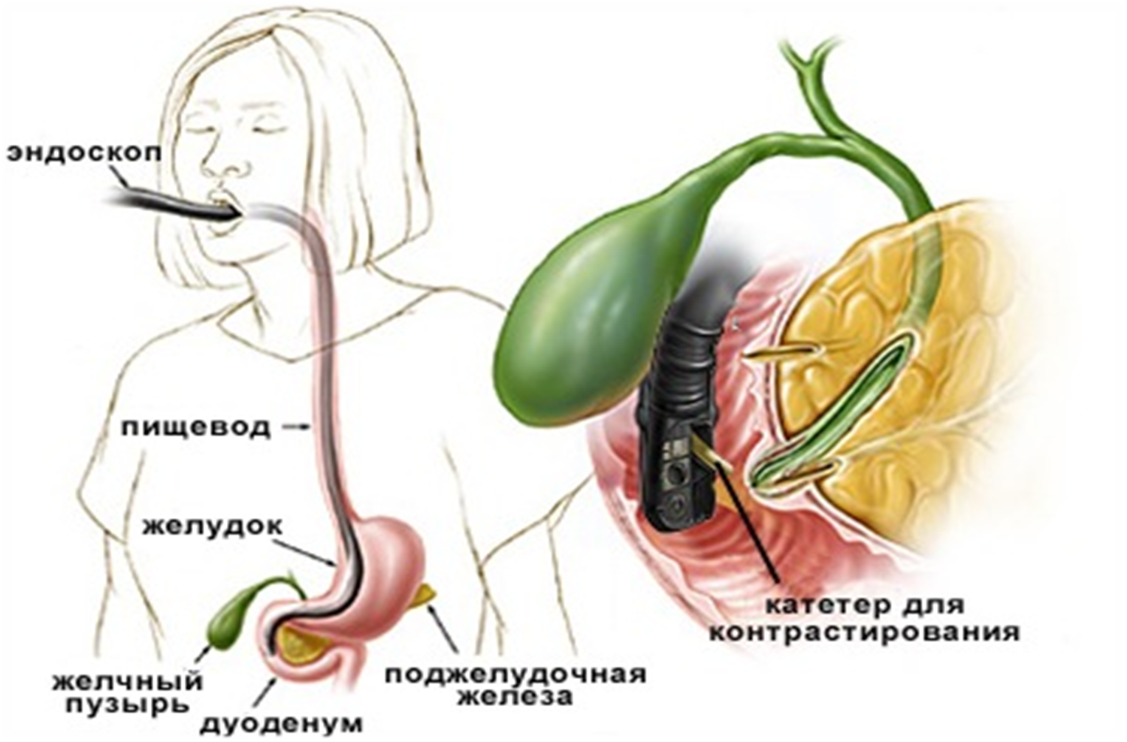
Endoscopic retrograde cholangiopancreatography (ERCP) , ЭРХПГ

Slide 68
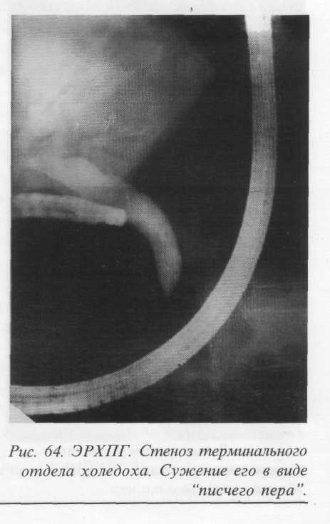
ERCP - stenosis of terminal choledochus. Narrowing it in the form of a "writing pen"

Slide 69
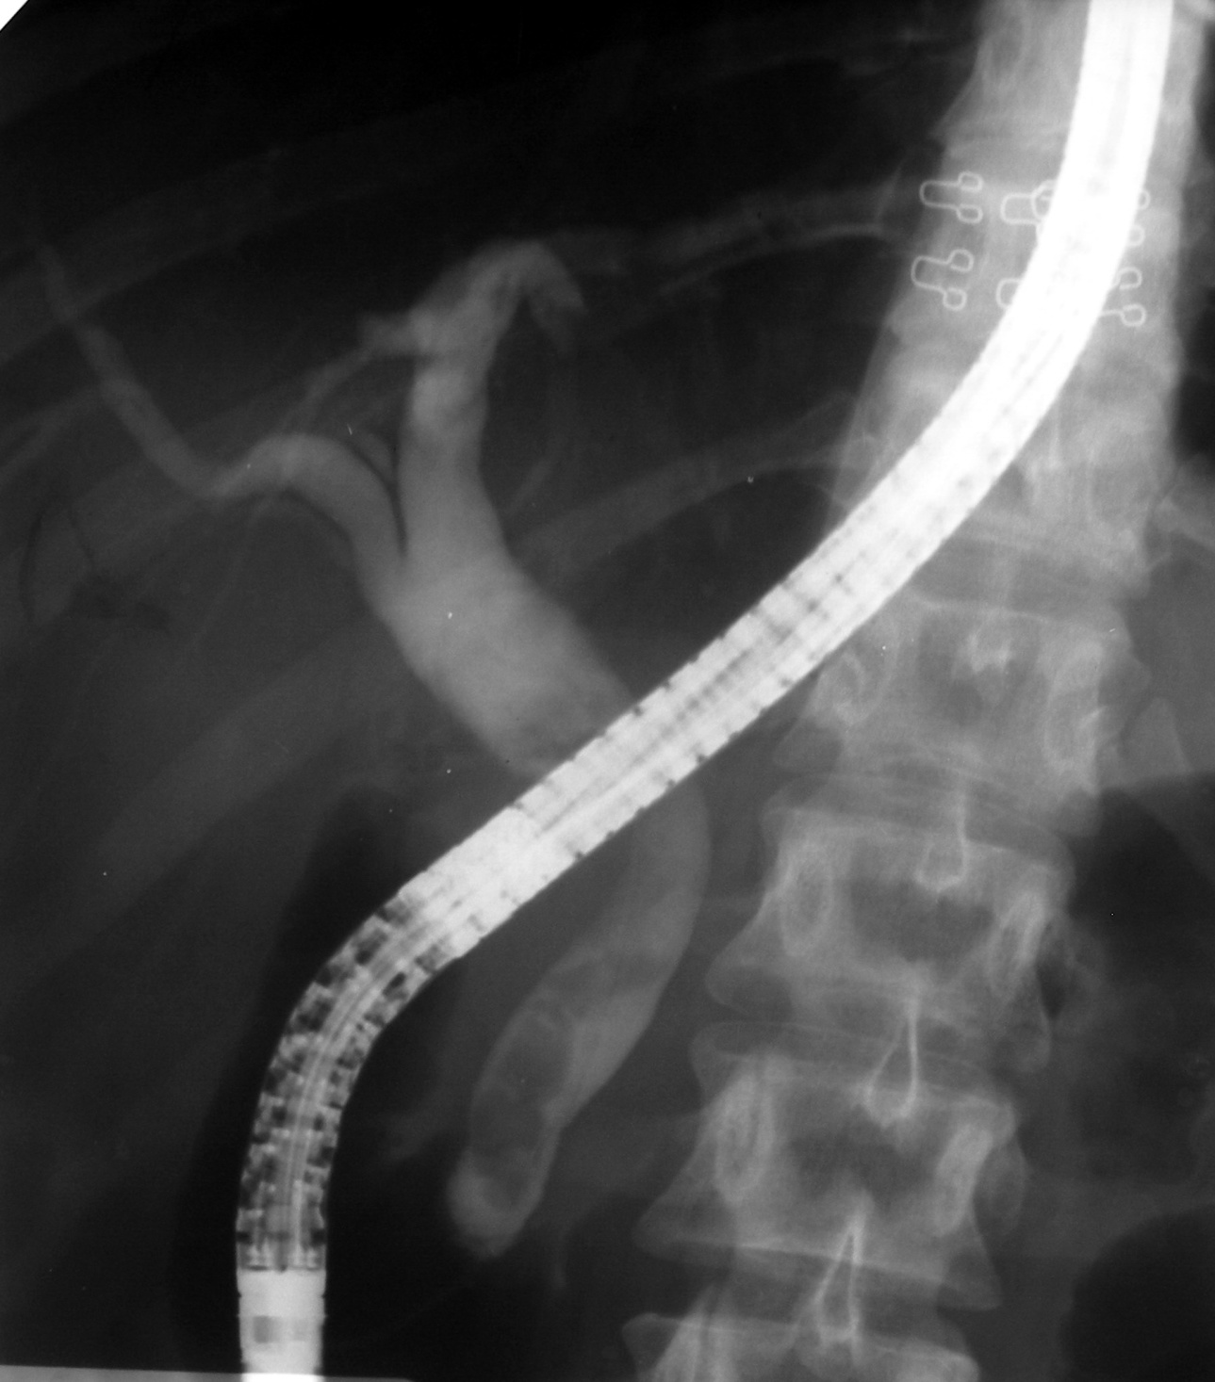
Эндоскопическое исследование
ERCP
(choledocholiasis)

Slide 70
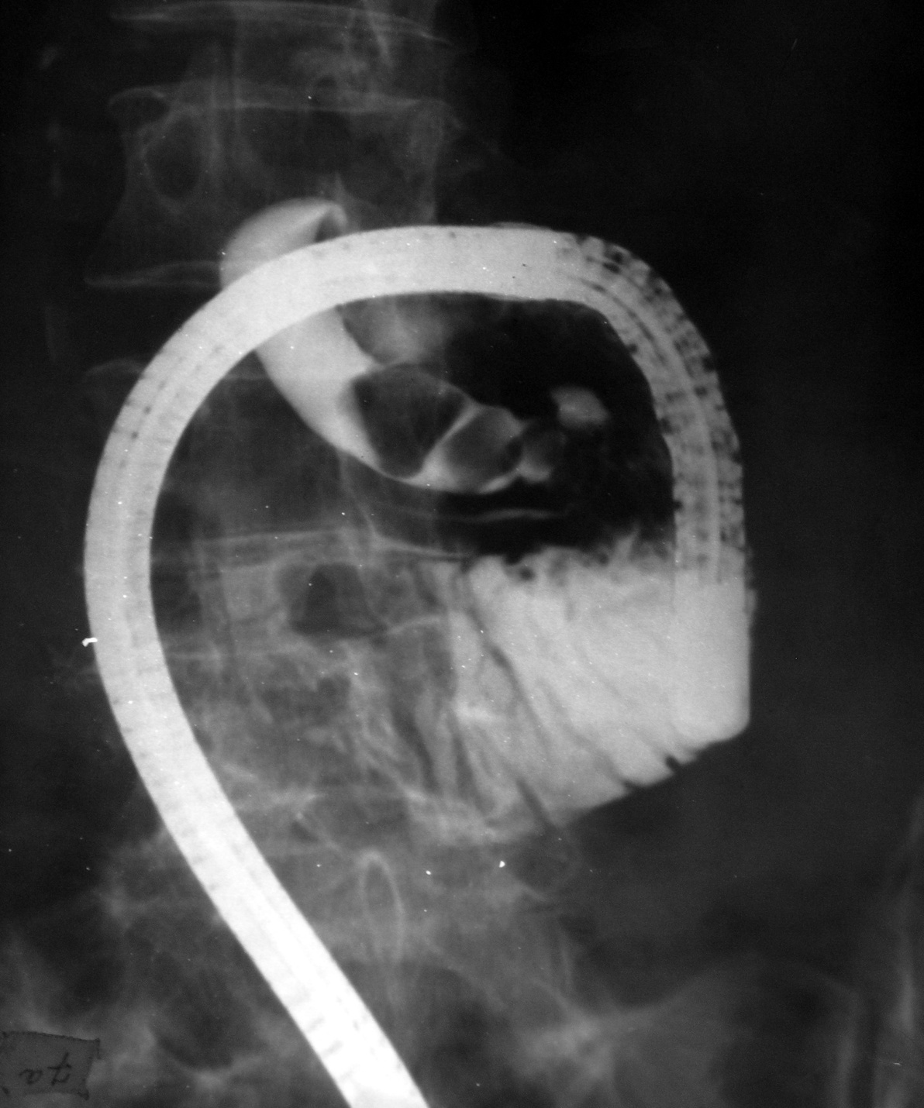
ERCP
(choledocholiasis)

Slide 71
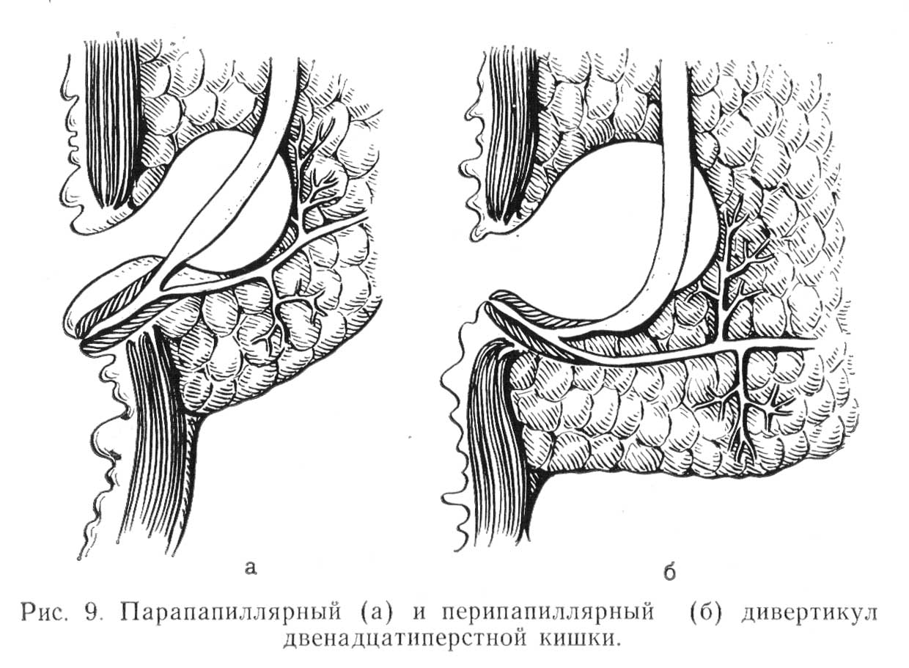
Diverticula duodenum (20%)

Slide 72
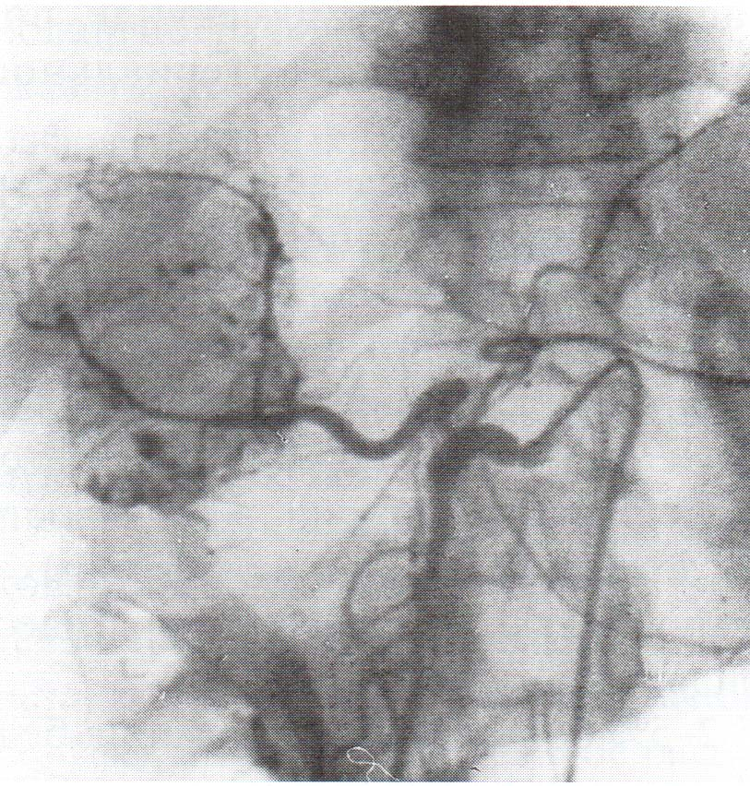
Selective celiacography. Tumor of the liver.

Slide 73
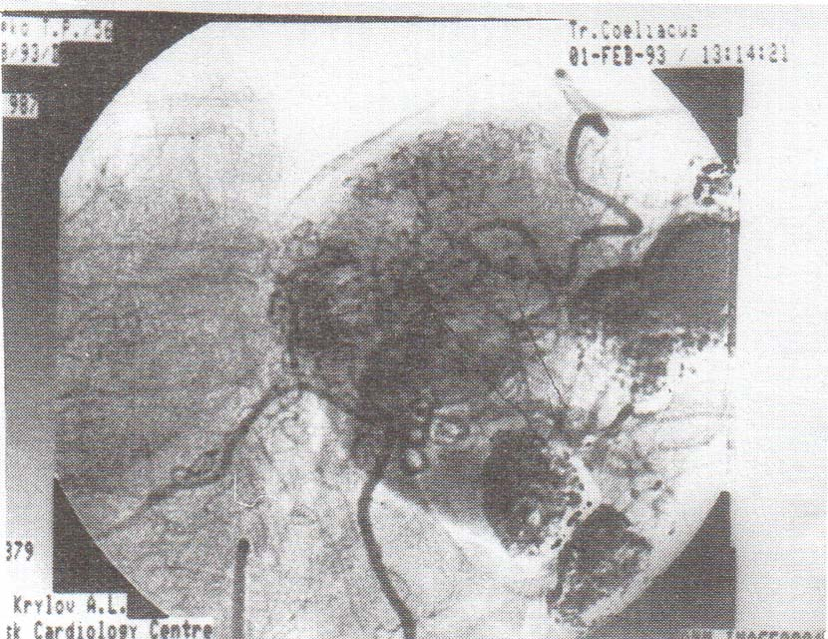
Angiogram. Saccular dilatation and tumor vessels.

Slide 74

CT scan. Tumor of the liver.

Slide 75

Laparoscopy + liver cancer biopsy.

Slide 76
Summary:
Despite the most advanced examination methods, the proportion of coincidence of preoperative and intraoperative diagnoses is about 80 - 90%, therefore, thorough intraoperative diagnosis

Slide 77
INTRAOPERATIVE DIAGNOSIS OF OBSTRUCTIVE JAUNDICE
Inspection
Palpation of the bile ducts
Measuring the diameter of the common bile duct
Transillumination
Cholangiomanometry
Intraoperative cholangiography (IoHG) - efficiency for choledocholithiasis 90 - 95%

Slide 78

INTRAOPERATIVE DIAGNOSIS OF OBSTRUCTIVE JAUNDICE
Intraoperative cholangiography through Halstead-Pikovsky drainage (stricture of the distal choledochus)

Slide 79

INTRAOPERATIVE DIAGNOSIS OF OBSTRUCTIVE JAUNDICE
Intraoperative cholangiography through Halstead-Pikovsky drainage, (opisthorchiasis of the common bile duct, contrast casting into the Wirsung duct, opisthorchis in the intrahepatic bile ducts)

Slide 80


Slide 81
INTRAOPERATIVE DIAGNOSIS OF OBSTRUCTIVE JAUNDICE
Research with probes of different diameters
Fibroholedoscopy - efficiency 98.3%
Intraoperative ultrasound - efficiency 96 - 98%
Choledochotomy
Urgent biopsy

Slide 82

CHOLEDOCHOSCOPY

Slide 83
Therapeutic tactics for obstructive jaundice
Obstructive jaundice of any etiology - an indication for emergency hospitalization of a patient in a surgical hospital and endoscopic or surgical treatment
With regressing jaundice - an operation 6-8 days after its disappearance
With progressive jaundice - an operation within 2-3 days from the time of admission
With stable jaundice - an operation within 7-10 days

Slide 84

The main components of preoperative preparation
Bile duct decompression (cholangiostomy, cholecystostomy, endoscopic papillosphincteromy with stone removal with a Dormia basket)

Slide 85
BILIARY DECOMPRESSION
The goal is to eliminate cholestasis and prevent the development of liver failure.
Types: ERCP + nasobiliary drainage, endoscopic cholecystostomy, if it is impossible to perform stoma placement: (cholecysto-, choledochostomy) by open method or percutaneous transhepatic cholangiostomy

Slide 86

Cholecystostomy

Slide 87


Slide 88
The main components of preoperative preparation
Detoxification - hemodilution with forced diuresis, lymph and hemosorption, plasmapheresis, etc.
Improving the function of hepatocytes - hepatoprotectors, protein preparations, vitamins
Fighting biliary tract infection - antibiotic therapy, VLOK, UFOK
Coagulation correction - hemostatic therapy
Immunomodulatory therapy

Slide 89
Treatment of obstructive jaundice
Endoscopic + MIT
Surgical
- Radical operations
- Palliative
Prevention and treatment of liver failure

Slide 90
Tasks of surgical interventions
Establishment of the cause and level of obstruction of the biliary tract
Eliminating the cause of jaundice
Restoration of the free passage of bile into the intestines or external abstraction of bile
Bile duct drainage

Slide 91
Indications for endoscopic papillosphincterotomy in patients with painful breast:
Recurrent or residual choledocholithiasis with stenosis of the large duodenal papilla
Isolated, unexpanded stenosis of the large duodenal papilla.
Acute cholangitis caused by benign or malignant diseases of the biliary tract.
Stenosis of a large duodenal papilla with a functioning or scar-narrowed choledochoduodenoanastomosis, hepaticojejunostomy (symptom of a blind sac).
Restenosis of the large duodenal papilla.

Slide 92


Slide 93


Slide 94


Slide 95

Fistulocholangiogram. Nasobiliary drainage

Slide 96

Choledochotomy in the supraduodenal part of the common bile duct, calculus removal.

Slide 97

Removal of stones of their common bile duct under the control of a choledochoscope.

Slide 98


Slide 99


Slide 100


Slide 101
Stenosis of the Vater papilla
By etiology: primary, secondary
By prevalence: isolated, extended
By the degree of narrowing:
1 degree diameter BDS more than 3 mm
2 degree diameter 1-3 mm
3 degree diameter is less than 1mm.

Slide 102
Clinic stenosis of Vater papilla:
Pain in the right hypochondrium
Obstructive jaundice
Cholangitis
Perhaps the development of pancreatitis

Slide 103

Laparotomy, transduodenal papillosphincterotomy

Slide 104

Laparotomy, transduodenal papillosphincterotomy

Slide 105

Laparotomy, transduodenal papillosphincterotomy

Slide 106

Laparotomy, transduodenal papillosphincterotomy

Slide 107

Pancreas cancer
The volume of organs to be removed with a “classical” pancreatoduodenal resection according toWhipple (1935)

Slide 108

PANCREATODUODENAL RESECTION

Slide 109

PANCREATODUODENAL RESECTION

Slide 110

PANCREATODUODENAL RESECTION

Slide 111

The pancreaticoduodenectomy (Whipple procedure) can be performed either with the standard technique, which includes distal gastrectomy (A), or with preservation of the pylorus (B). The pylorus-sparing version of the procedure is used most commonly.

Slide 112



Stenting
Biliary stents: metal and plastic

Slide 113

Stent Endoscopic Installation Diagram

Slide 114

Stent Endoscopic Installation Diagram

Slide 115


Plastic and metal stents. Endoscopic picture

Slide 116
Surgical treatment of strictures of the common bile duct
I. Recovery operations (restoration of patency of ducts)
1. Endobiliary interventions under ultrasound or X-ray control (bougienage, balloon dilatation, stenting of the bile duct).
2. Plastic of stricture
3. Resectable strictures can be resected with primary anastomosis.
II. Reconstructive surgery (application of biliodigestive anastomoses)
1. Extrahepatic bile duct anastomoses :
а) choledocho-duodenostomy
б) hepatico-jejunostomy.
2. Anastomoses of the intrahepatic bile ducts with a segment of the jejunum isolated by Roux or stomach with high strictures

Slide 117


Slide 118

Choledochoduodenostomy

Slide 119

Choledochojunoanastomosis

Slide 120


Slide 121


Slide 122

Рисунок 15. Бигепатикоеюностомия на одном СТД по Э.И. Гальперину

Slide 123

The operation of recanalization and endoprosthetics (operation Smith - Pradery)

Slide 124

Thanks for your attention!

